Slide 1

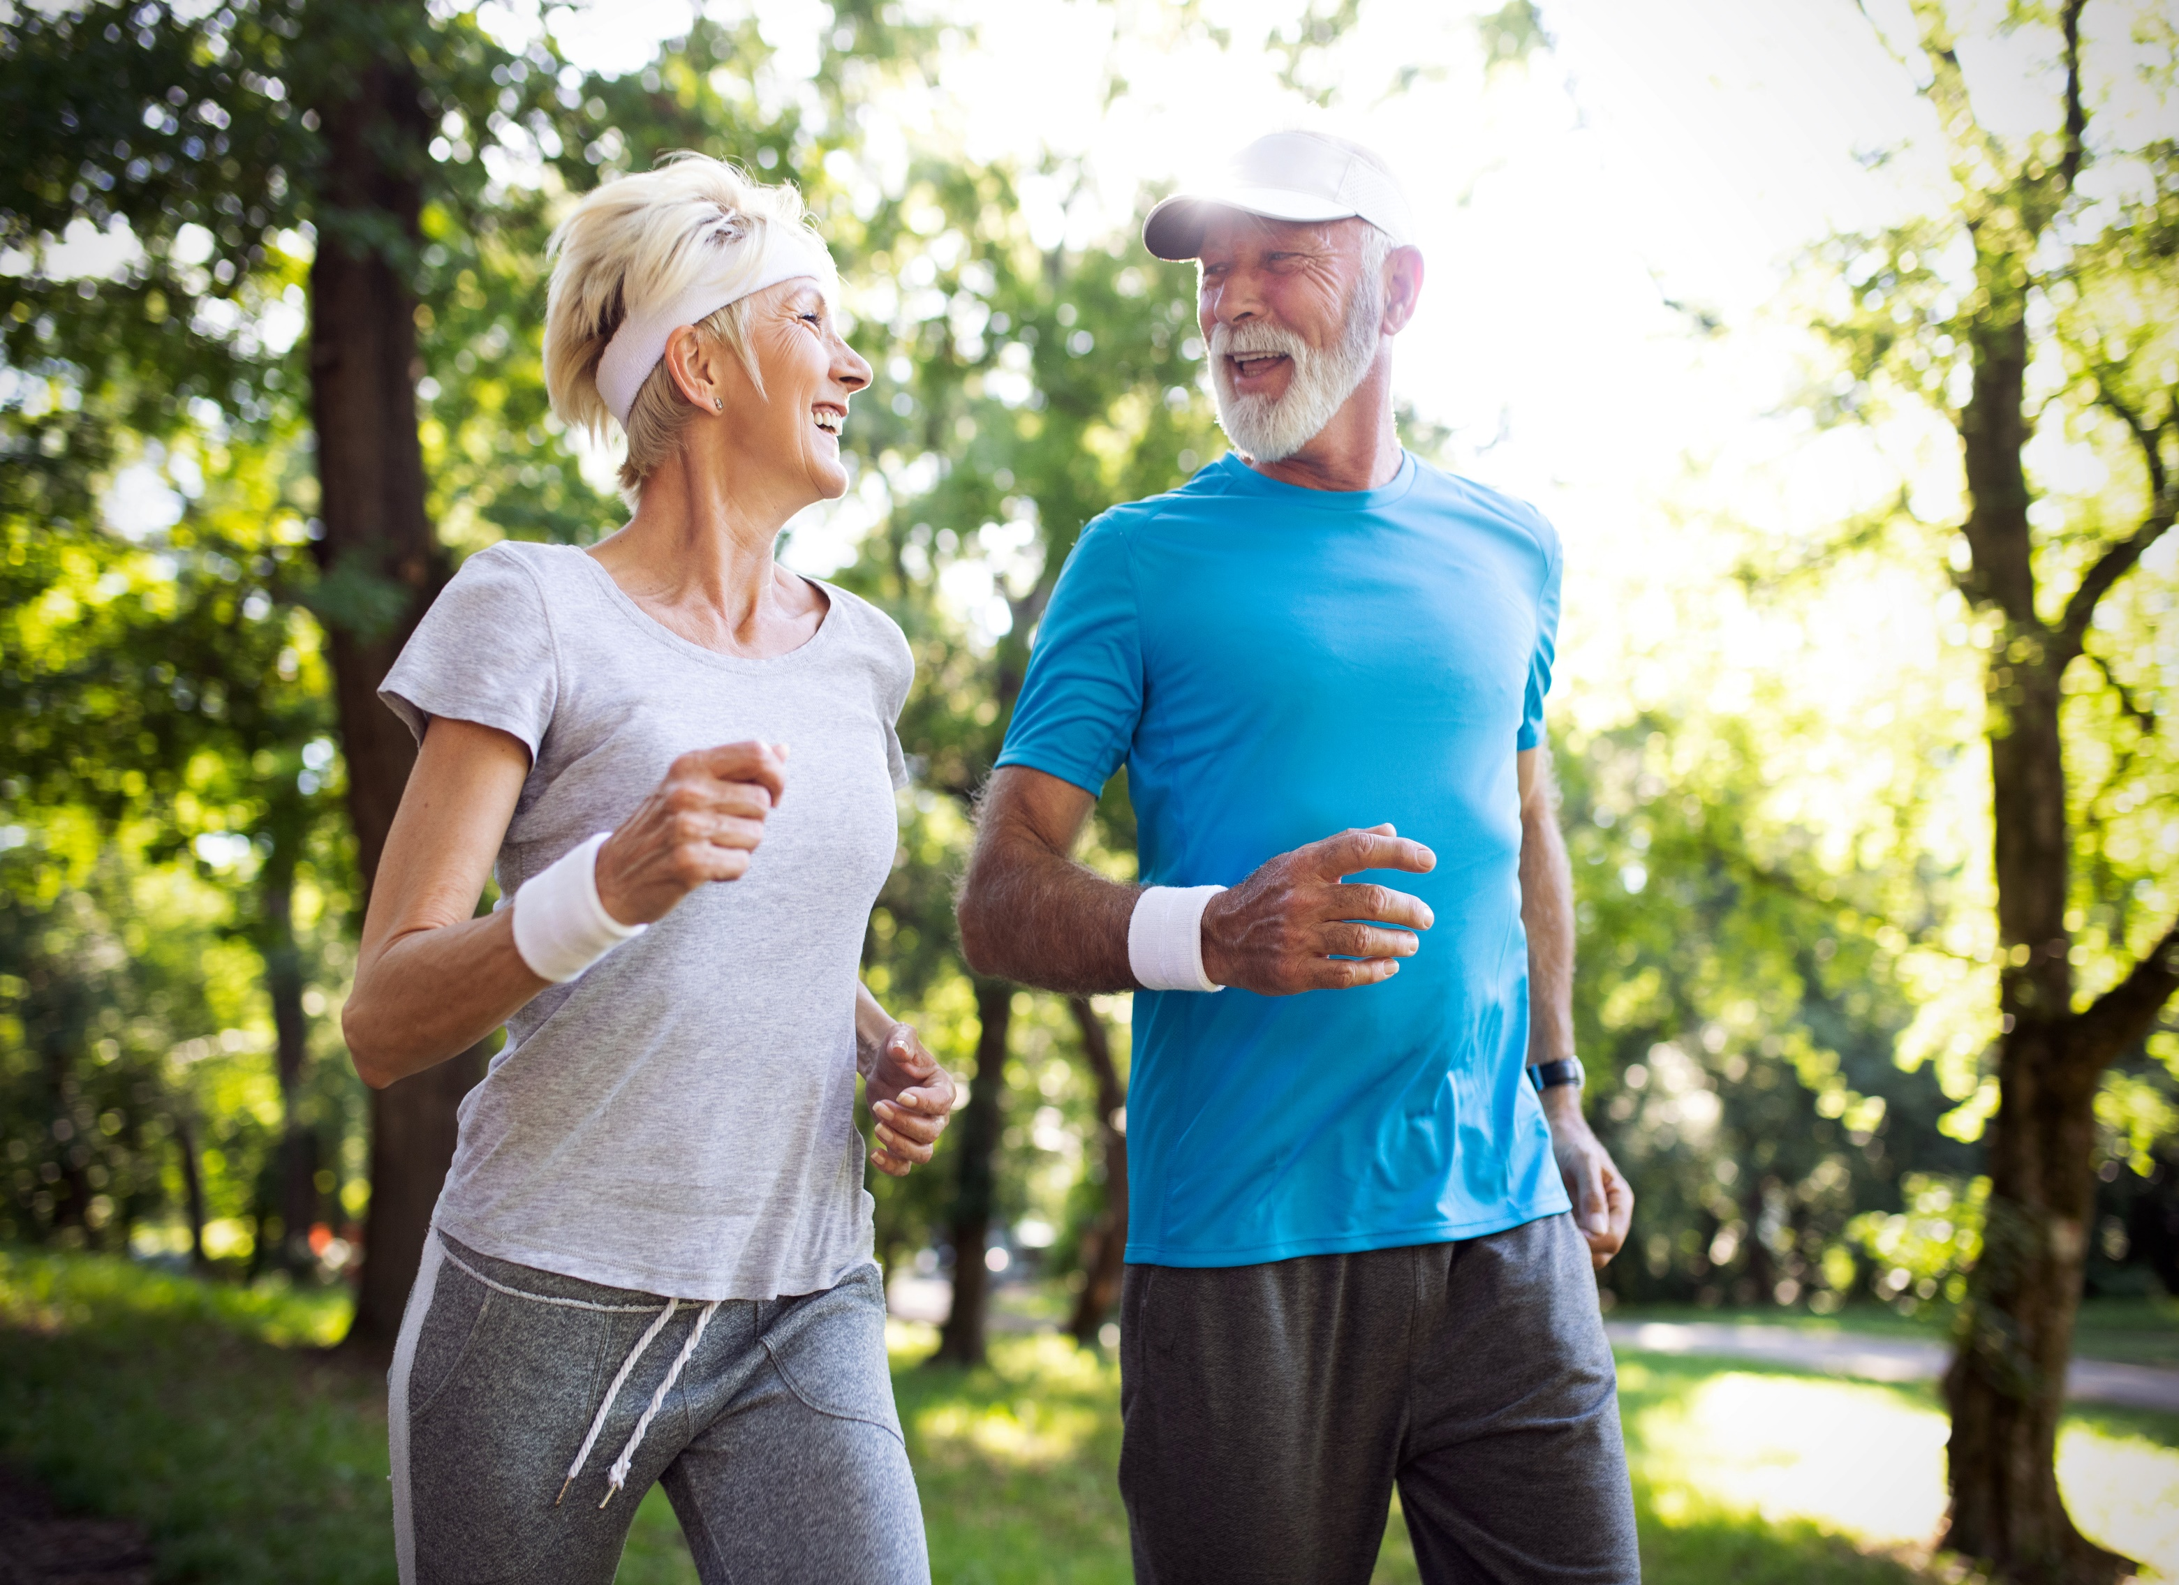

CHCCCS041
Recognise healthy body systems (Release 1)

Slide 2
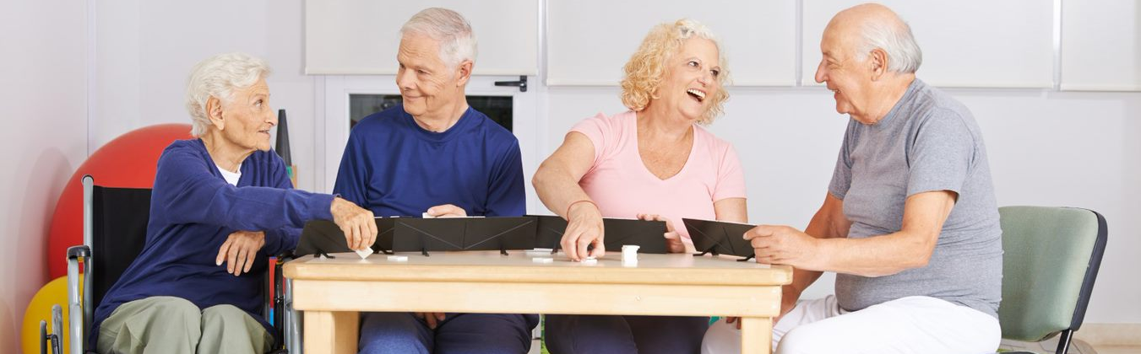
About this Unit of Competency
CHCCCS041 - Recognise healthy body systems (Release 1)
This unit describes the performance outcomes, skills and knowledge required to work with basic information about healthy body systems and the impacts of ageing and disability.
This unit applies to workers across a range of community services contexts.

Slide 3

Presentation Objectives
At the end of this session, you will be able to:
Work with information about the human body
Recognise and promote ways to support healthy functioning of the body

Slide 4


Introduction
The World Health Organization (WHO) defines health as the ‘state of complete physical, mental and social well-being and not merely the absence of disease or infirmity.’
A healthy body is not one without diseases or infirmities.
Overall, a healthy body pertains to various systems in the body functioning at their own best.

Slide 5
Service delivery to clients who are ageing and/or with a disability will greatly differ from that outside this spectrum.
Age and disability are two of the many factors that affect the overall function and makeup of the overall body system.
Knowing how they impact a healthy body will make a difference in delivering quality service in your field of work.

Slide 6
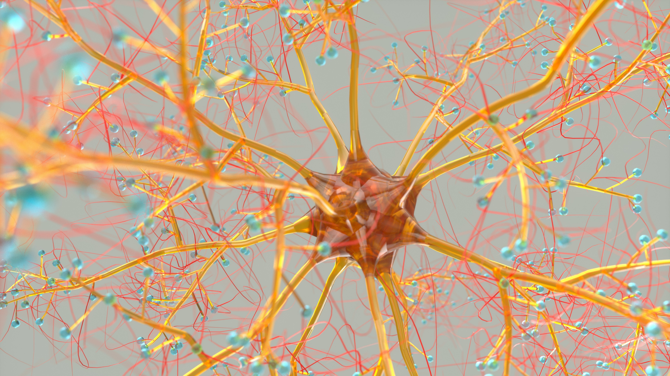
Work With Information About the Human Body
CHCCCS041 - Recognise healthy body systems (Release 1)

Slide 7
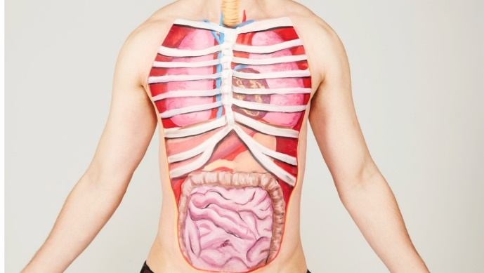
The human body is comprised of various organs with different functions.
To effectively work with information about it, you must first understand its basic makeup from the body systems' fundamental structure, functions, interactions and associated components.
Work With Information About the Human Body

Slide 8
Anatomy and physiology can help you understand the following:
Function of the body
Framework of body parts
Location of various organs
Location of cells and tissues
Knowledge regarding body systems (e.g. nervous system)
Work With Information About the Human Body

Slide 9
As someone who works in community services, it is essential that you know not only the theoretical concepts but practical functionalities of the human body too.
The following are just some scenarios wherein you can practice your practical knowledge and skills about the human body:
Emergency
Health monitoring
Quick analysis
Work With Information About the Human Body

Slide 10
Not having the appropriate skills and knowledge about the fundamentals of the human body can lead to consequences such as:
Overlooked serious signs and symptoms
Sometimes even death
This is not impossible to happen, especially if you relayed incorrect information of the location or the function of body systems or interpreted medical advice inaccurately.
Work With Information About the Human Body

Slide 11
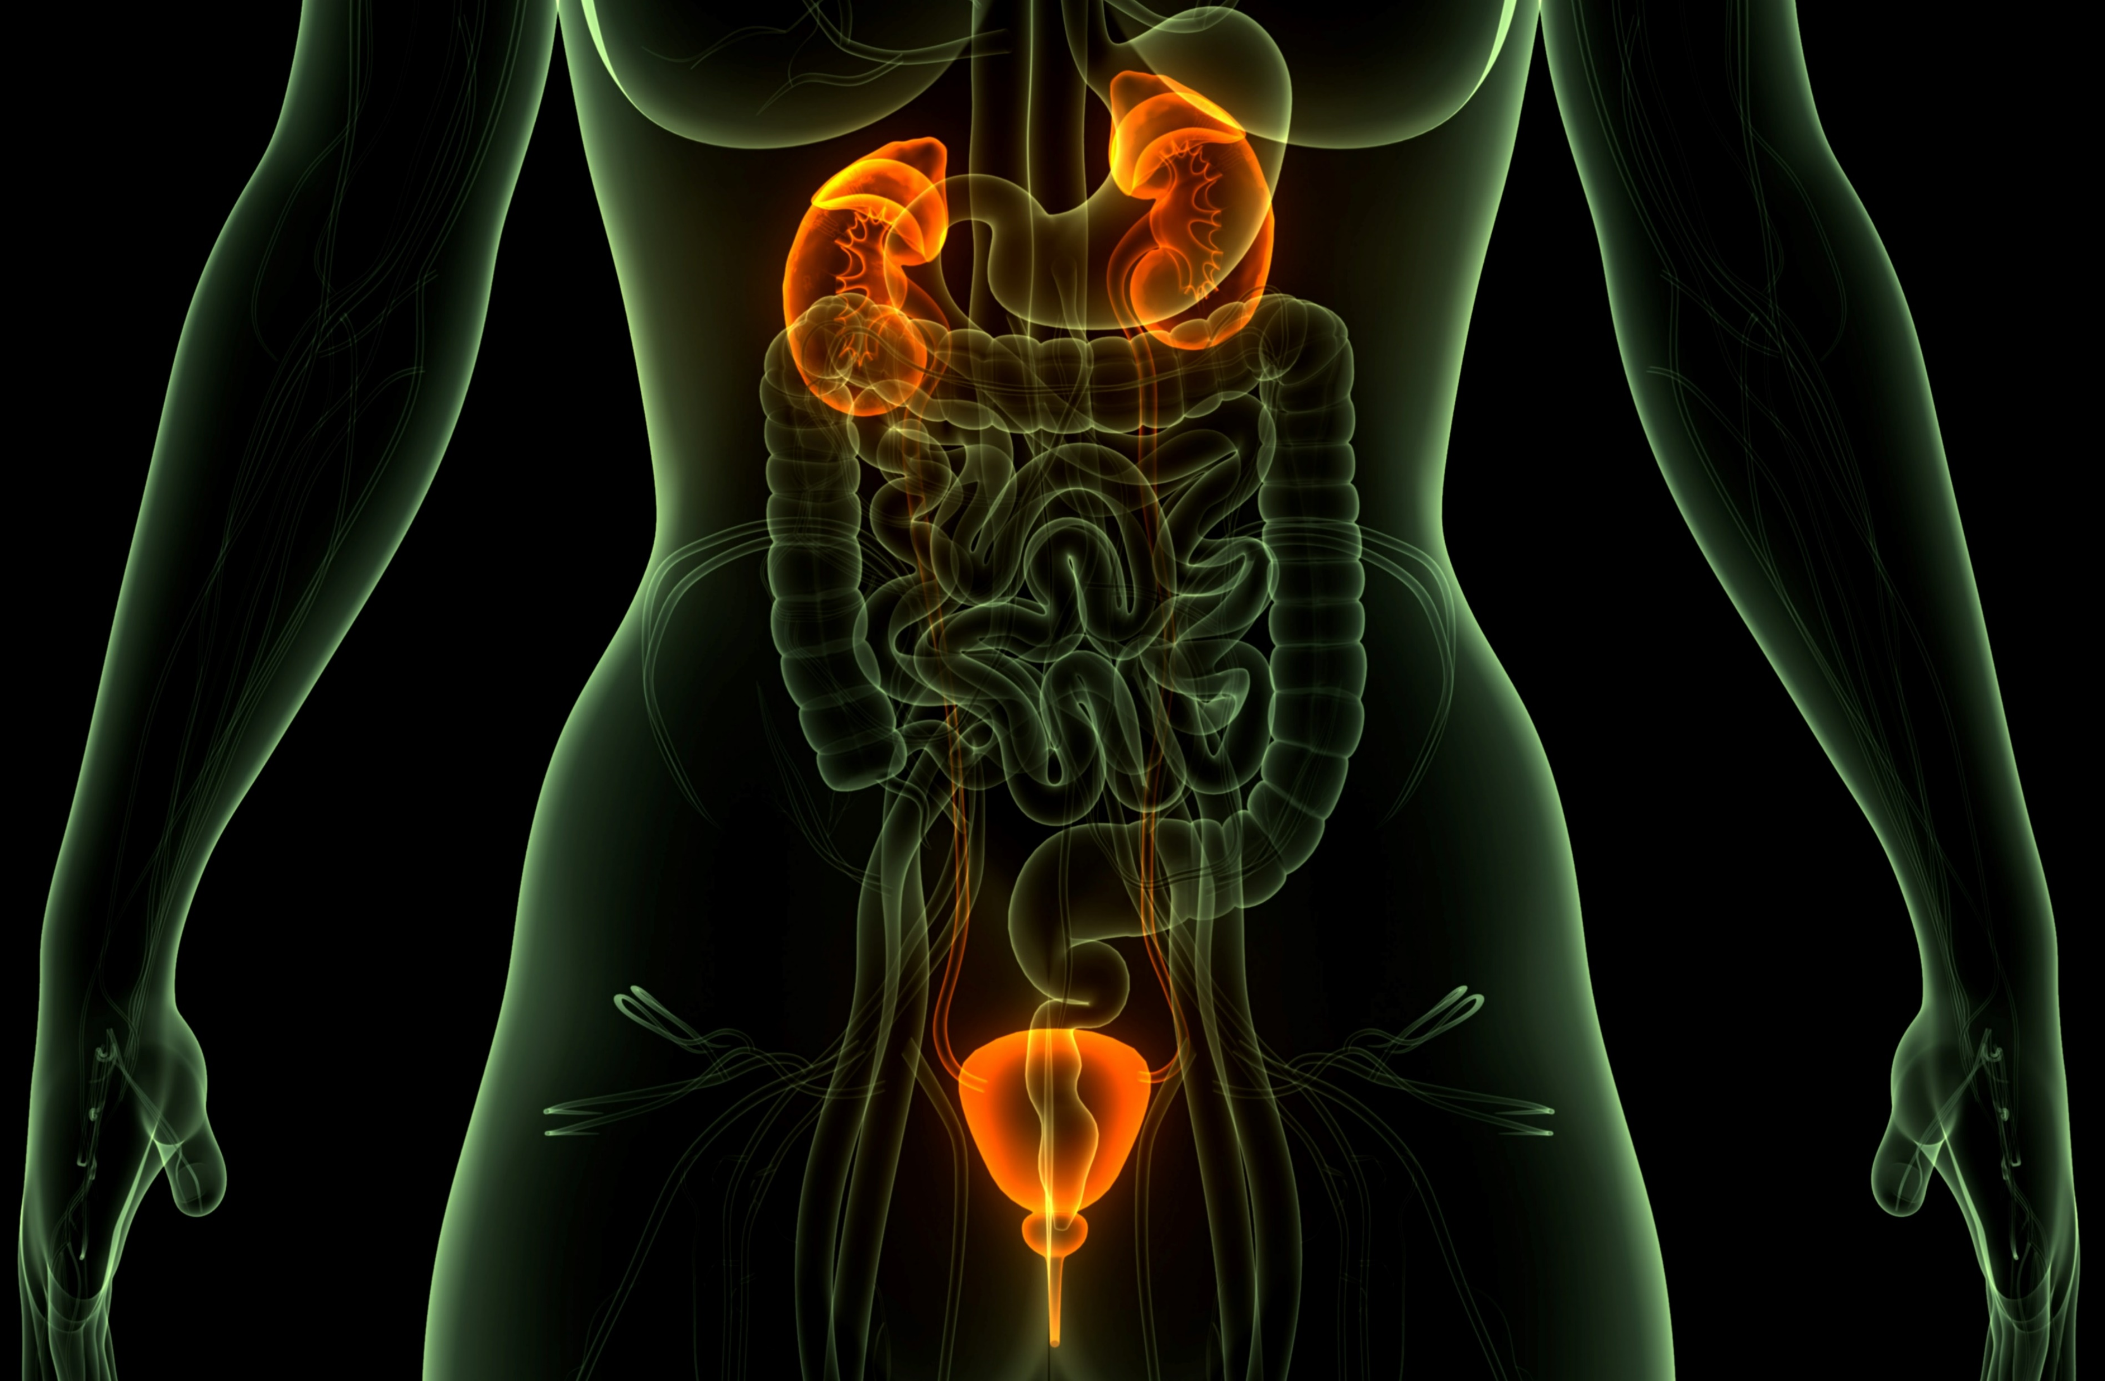
Levels of Organisation of the Human Body
To gain knowledge of important information about body systems, you must first refresh your mind with the basic makeup of the body from the simplest level to the most complex.
Work With Information About the Human Body

Slide 12
The level of the basic organisation of a human body system can be categorised into the following:
Cells
The basic unit of life
Tissues
Clusters of cells performing a similar function
Work With Information About the Human Body

Slide 13
The level of the basic organisation of a human body system can be categorised into the following:
Organs
Consists of a group of organs that work together to perform one or more functions
Made of tissues performing one specific function
Organ System
Work With Information About the Human Body

Slide 14
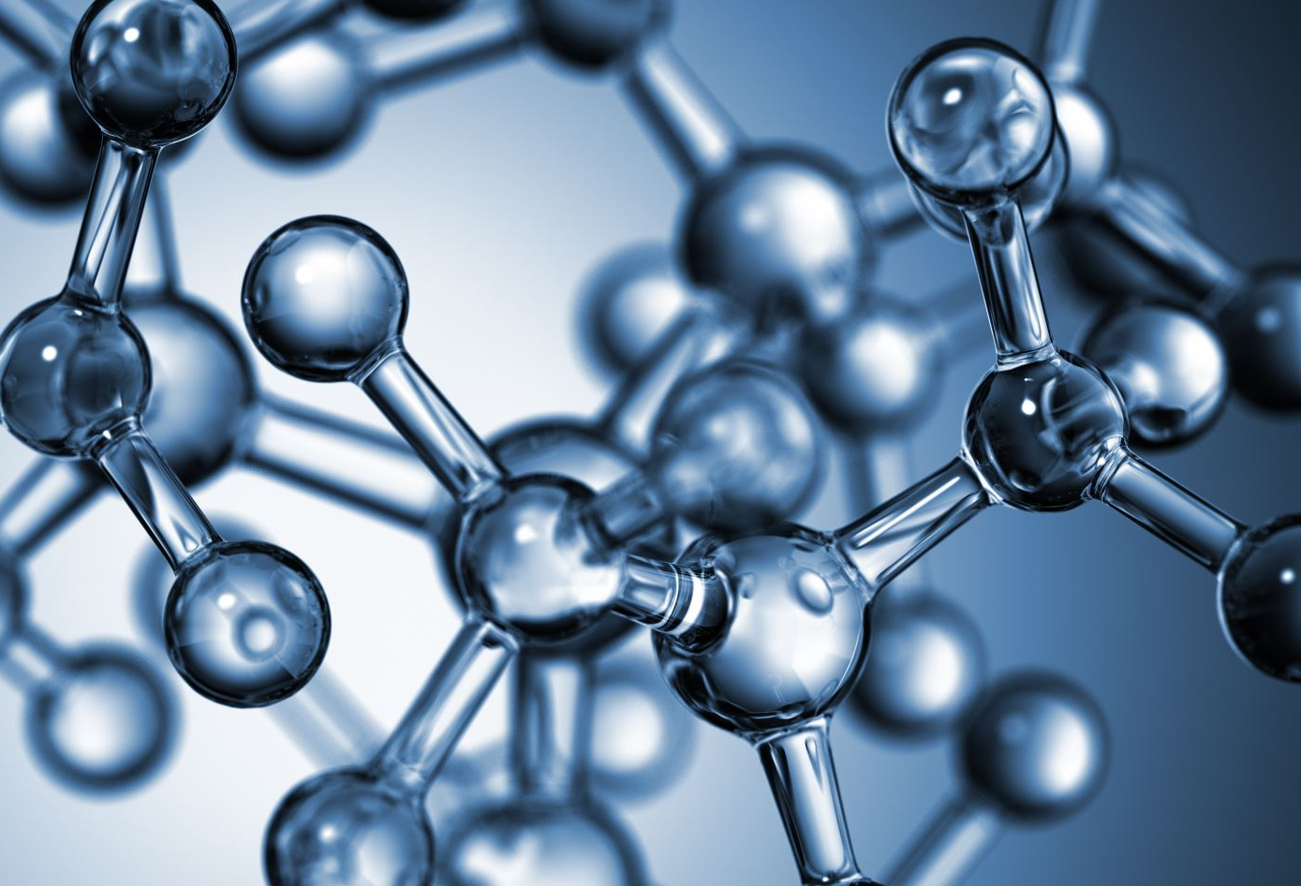
All living things, including humans, are made up of cells.
The cell is the basic unit of all living things.
Its basic functions include metabolism and reproduction.
Work With Information About the Human Body

Slide 15
There are different types of cells with various functions. These functions include:
Provide structure for the body
Take in nutrients from food
Convert those nutrients into energy
Carry out specialized functions
Holds the body’s genetic code and can duplicate themselves
Work With Information About the Human Body

Slide 16
Our bodies are made up of trillions of cells.
They group to form tissues, which carry out a particular task in an organism.
Following are the basic functions of tissues:
Secretion
Movement
Strength
Excretion
Communication
Work With Information About the Human Body

Slide 17
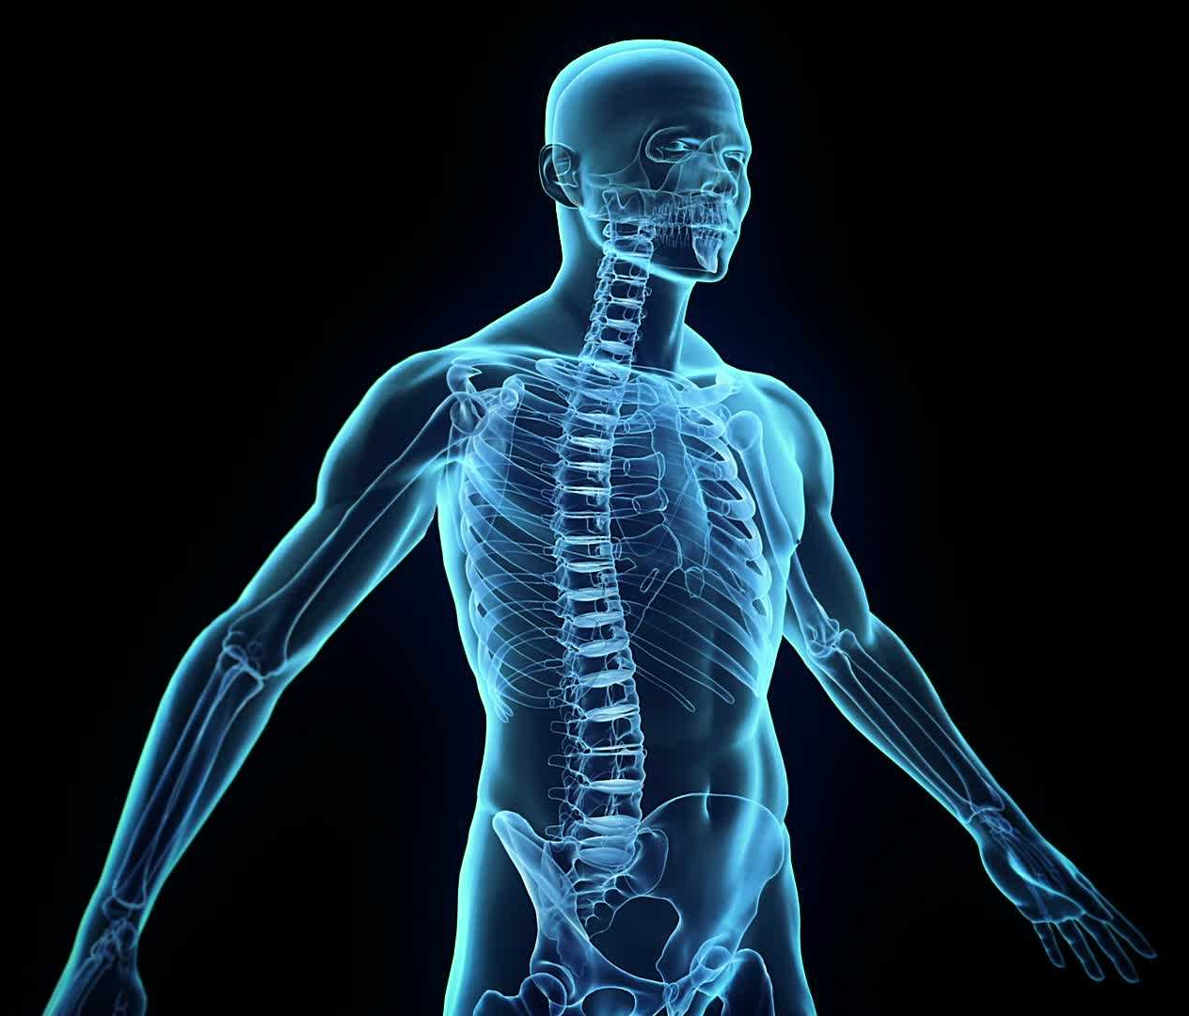
A group of tissues form organs, which perform specific functions in the human body.
Overall, organ systems are comprised of organs, e.g. the respiratory system.
The cells’ unique function serves a larger purpose together in the organisation of the organs in the body.
Work With Information About the Human Body

Slide 18
The organ systems in the human body are as follows:
Cardiovascular system
Respiratory system
Musculoskeletal system
Endocrine system
Digestive system
Urinary system
Reproductive system
Integumentary system
Lymphatic (immune) system
Nervous system
Senses of the body
Work With Information About the Human Body

Slide 19
Below are the different functions of the different organ systems:
Organ System | Function
Cardiovascular system | The cardiovascular system transports blood from the heart to the other parts of the body.
Respiratory system | The respiratory system brings oxygen in and carbon dioxide out.
Musculoskeletal system | The musculoskeletal system facilitates movement and locomotion.
Work With Information About the Human Body

Slide 20
Below are the different functions of the different organ systems:
Organ System | Function
Endocrine system | The endocrine system secretes hormones into the circulatory system.
Digestive system | The digestive system breaks down food into energy.
Urinary system | The urinary system removes liquid waste from the blood to keep a stable balance of salts and other substances in the blood.
Work With Information About the Human Body

Slide 21
Below are the different functions of the different organ systems:
Organ System | Function
Female reproductive system | The reproductive system produces, transports, and sustains egg cells. It also nurtures the developing offspring.
Male reproductive system | The reproductive system produces, transports, and sustains sperm cells.
Work With Information About the Human Body

Slide 22
Below are the different functions of the different organ systems:
Organ System | Function
Integumentary system | The integumentary system serves as a barrier to protect the inside of the body from elements in the environment, such as bacteria, pollution, and UV rays from the sun.
Lymphatic system | The lymphatic system transports fluid containing infection-fighting white blood cells throughout the body.
Work With Information About the Human Body

Slide 23
Below are the different functions of the different organ systems:
Organ System | Function
Nervous system | The nervous system carries information from the brain to other parts of the body.
Immune system | The immune system provides body protection from infections/diseases.
Work With Information About the Human Body

Slide 24
Those people aged 65 or older are considered elderly.
Meanwhile, people with disability are those who may have any of the following conditions:
Type of disability | Description
Physical disability | These are disabilities that may affect, either temporarily or permanently, a person’s physical capacity and mobility.
Cognitive disability | These are conditions that affect the ability to perform one or more mental tasks.
Work With Information About the Human Body

Slide 25
Those people aged 65 or older are considered elderly.
Meanwhile, people with disability are those who may have any of the following conditions:
Type of disability | Description
Intellectual disability | It is a developmental disorder characterised by intelligence limitations and significant difficulty with daily living skills.
Psychosocial disability | It is a disability that may arise from a mental health issue (NDIS).
Work With Information About the Human Body

Slide 26
Those people aged 65 or older are considered elderly.
Meanwhile, people with disability are those who may have any of the following conditions:
Type of disability | Description
Hearing impairment | This interferes with a person’s ability to hear and, in severe cases, totally prevents a person from hearing and distinguishing sounds.
Vision impairment | It includes communication disorders and impairments involving one’s hearing, fluency, and ability to articulate words.
Work With Information About the Human Body

Slide 27
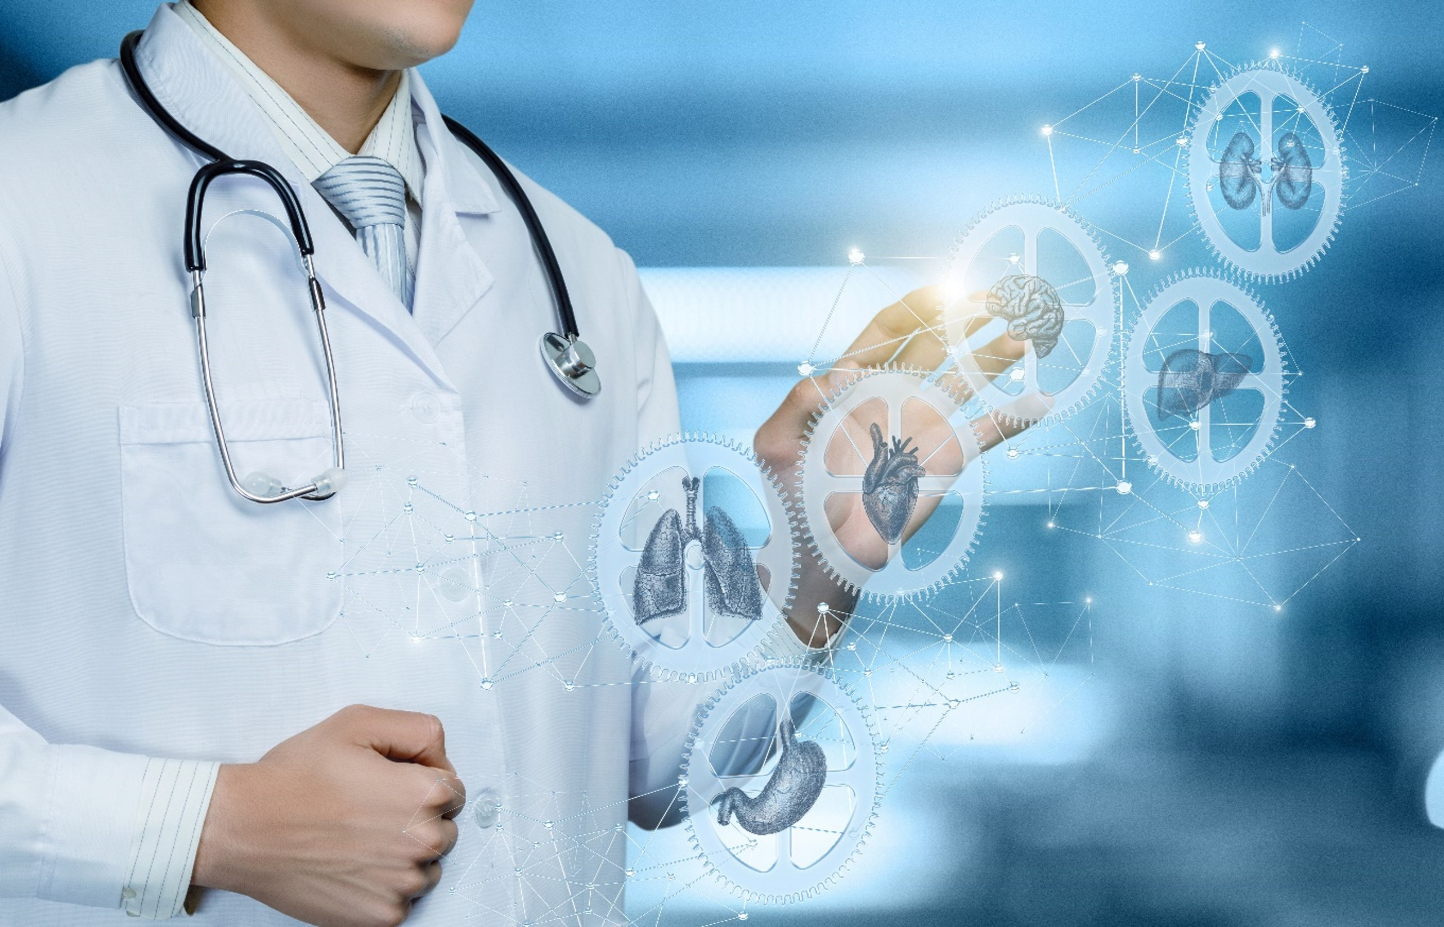
1.1
Interpret Health Terms Relevant to the Major Body Systems

Slide 28
In community services, the usage and interpretation of specific vocabulary relevant to health and the body are part of standard service delivery.
When you speak to your clients and/or patients, you use health-related terminologies to explain different body-related facts.
You also interpret medical advice from professionals to your clients and/or patients whenever needed.
Work With Information About the Human Body

Slide 29
In short, using health-related terminologies and abbreviations relevant to body systems will help you in performing tasks in your work role, such as:
Interpreting medical advice to the client given by the doctor
Recognising changes in the physical, psychological and mental condition of the client and/or patient
Reporting indicators of body system issues
Interpreting content to implement in clients’ individualised plans
Taking note of clients’ health conditions accurately
Work With Information About the Human Body

Slide 30

While the common documents containing health-related terminologies and abbreviations that you will be interpreting may include:
Doctor’s prescriptions
Client’s individualised care plans
Work With Information About the Human Body

Slide 31
While the common documents containing health-related terminologies and abbreviations that you will be interpreting may include:
Client’s medical documents with information on:
Previous hospitalisations
Previous surgeries
Allergies
Medications
Work With Information About the Human Body

Slide 32
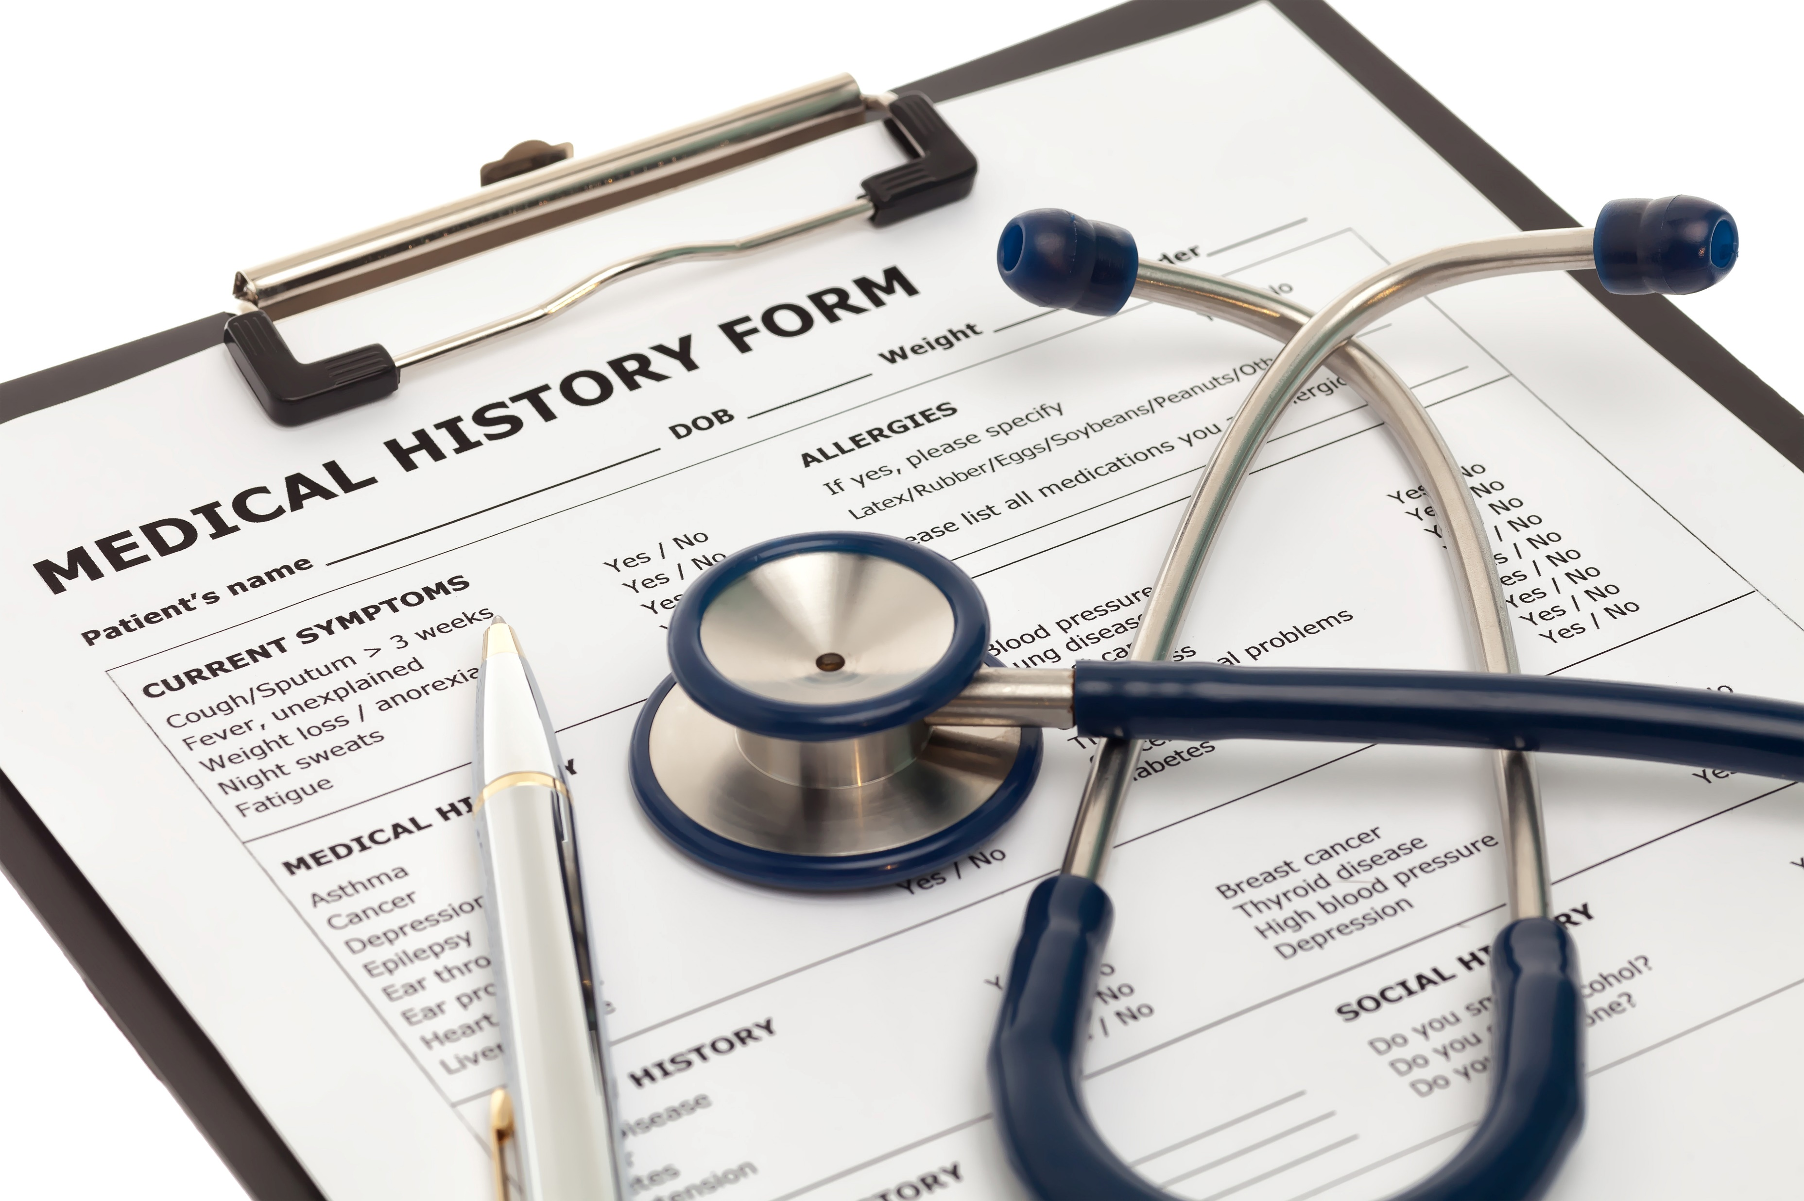
While the common documents containing health-related terminologies and abbreviations that you will be interpreting may include:
Client’s medical documents with information on:
Client’s medical history
Client’s family history of illnesses
Work With Information About the Human Body

Slide 33
You will need to access other documents to interpret the clients’ needs properly.
What is important is that you have a thorough knowledge of the common terminologies and abbreviations used in your field of practice.
Listed on the next slide are the common terms and abbreviations that you will often see in the aforementioned documents.
Work With Information About the Human Body

Slide 34
Medical Terminology
You must consider the anatomical terminologies since many of them are recurring terms used in different body systems.
Knowing these terms will make it easier for you to understand body systems-related topics in this subchapter moving forward.
Work With Information About the Human Body

Slide 35

Some important terminology include:
Planes of the Body
The following describes the location of structures in the body as a whole.
They are commonly used to describe medical images captured by CAT scans, MRIs, etc.
Work With Information About the Human Body

Slide 36
These are the following:
Terminology | Description
Sagittal Plane (Lateral Plane) | A vertical plane from front to back that divides the body into right and left sides
Median plane | Is a Sagittal Plane through the middle of the body that divides it or any of its parts into right and left halves
Work With Information About the Human Body

Slide 37
These are the following:
Terminology | Description
Coronal Plane (Frontal Plane) | A vertical plane divides the body into anterior and posterior portions from side to side
Axial Plane (Transverse Plane) | A horizontal plane that divides the body into upper and lower parts
Work With Information About the Human Body

Slide 38
Some important terminology include:
Other basic medical terminologies
Below are other helpful general medical abbreviations and terms that are commonly seen in a client’s medical documents and profile:
Terminology | Explanation
Abrasion | A wound caused by superficial damage to the skin and no deeper than the epidermis
Cardi- or cardio- | The heart or pertaining to the heart.
Work With Information About the Human Body

Slide 39
Below are other helpful general medical abbreviations and terms that are commonly seen in a client’s medical documents and profile:
Terminology | Explanation
Cephalgia | The medical term for headache; it is pain anywhere in the region of the head or neck
Contusion | (also called a bruise) a type of hematoma of tissue where the capillaries and venules are damaged by trauma
Febrile | Having or showing symptoms of a fever
Work With Information About the Human Body

Slide 40
Below are other helpful general medical abbreviations and terms that are commonly seen in a client’s medical documents and profile:
Terminology | Explanation
Pathogen | Infectious agent (or anything that can produce a disease), e.g. virus, bacterium, fungus
Work With Information About the Human Body

Slide 41
Medical Abbreviations
Various abbreviations can reveal a variety of information.
They are often abbreviated to make it easier for medical professionals to express a condition, state or treatment.
Your job is to relay the accurate description of what each of the following means should your client be unfamiliar with them.
Work With Information About the Human Body

Slide 42
Below are commonly used medical abbreviations relevant to the body system that often appear in medical documents:
Medical abbreviation | What is this? | What it stands for
CBC | A blood test used to assess overall health and detect a wide range of disorders. | Complete blood count
UTI | Infection of one or more organs in the urinary tract. | Urinary tract infection
Work With Information About the Human Body

Slide 43
Below are commonly used medical abbreviations relevant to the body system that often appear in medical documents:
Medical abbreviation | What is this? | What it stands for
Dx | The process of identifying a disease based on signs, symptoms, and tests. | Diagnosis
Px | Prediction of the outcome of a disease | Prognosis
URI | Also referred to as the common cold | Upper respiratory infection
Work With Information About the Human Body

Slide 44
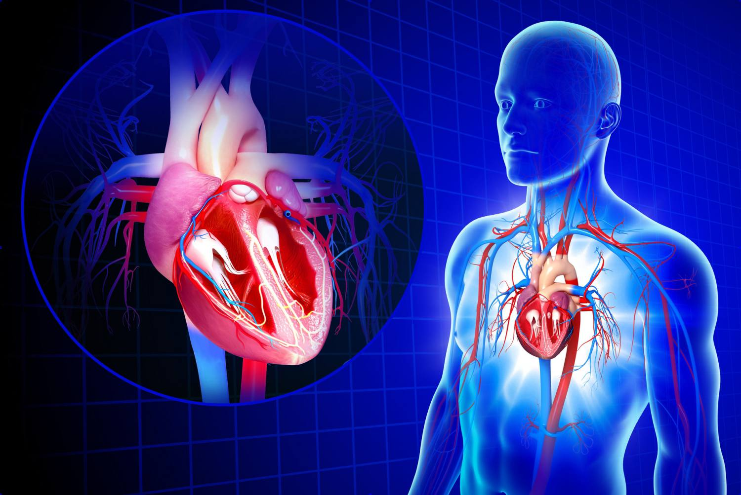
1.1.1 Cardiovascular System
The cardiovascular system is responsible for:
Transporting oxygen, blood cells, water and nutrients around the body.
Picking up waste and transporting them to organs to be removed
Work With Information About the Human Body

Slide 45
The common terminologies that you will encounter when talking about the cardiovascular system are comprised of the following body organs and parts:
The heart
Blood
Veins
Arteries
Capillaries
Work With Information About the Human Body

Slide 46
Below are details where they are located in your body, how they are structured and how it functions:
The Heart
Behind the breastbone, located between the lungs, and in the middle of the chest
Divided into four chambers
Pumps out blood throughout the body
The heart has many parts which helps it perform its vital function.
Work With Information About the Human Body

Slide 47
Some of the pivotal parts of the heart include the blood vessels.
They are tubes through which blood circulates in the body with each having a different function.
Blood vessels include:
Arteries - transports oxygenated blood from the heart to all parts of the body.
Veins - carries blood to be returned to the heart.
Capillaries - smallest blood vessels in the body
Work With Information About the Human Body

Slide 48
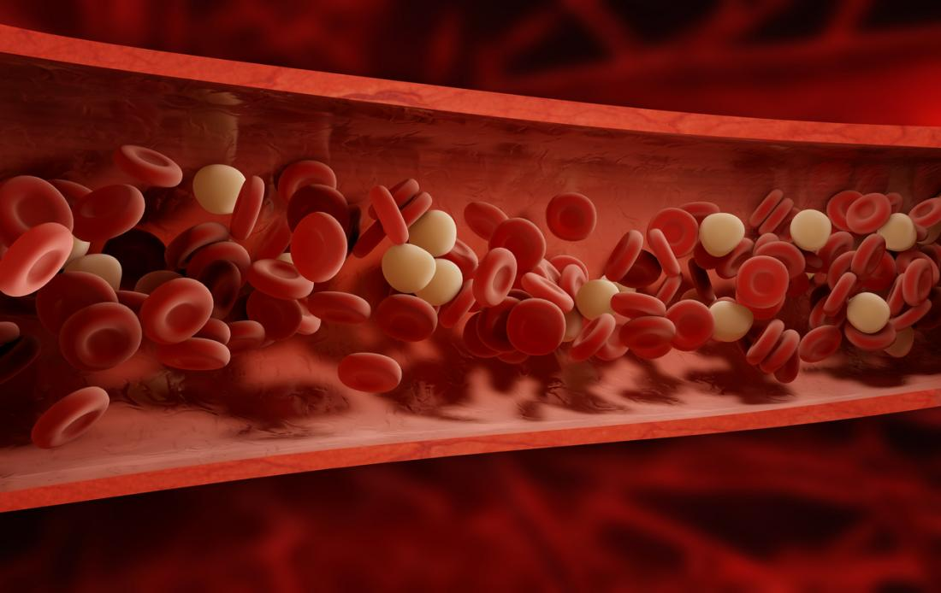
Below are details where they are located in your body, how they are structured and how it functions:
Blood
Blood is considered the essential fluid that circulates in the heart, arteries, capillaries, and veins.
Work With Information About the Human Body

Slide 49
It gives nourishment and oxygen to and bring away waste products from all parts of the body. The blood cells include:
Red blood cells
Carry oxygen and carbon dioxide
White blood cells (leukocytes)
Produce antibodies and destroy bacteria
Platelets (thrombocytes)
Form clots by binding together when there is damage to the blood vessel
Work With Information About the Human Body

Slide 50
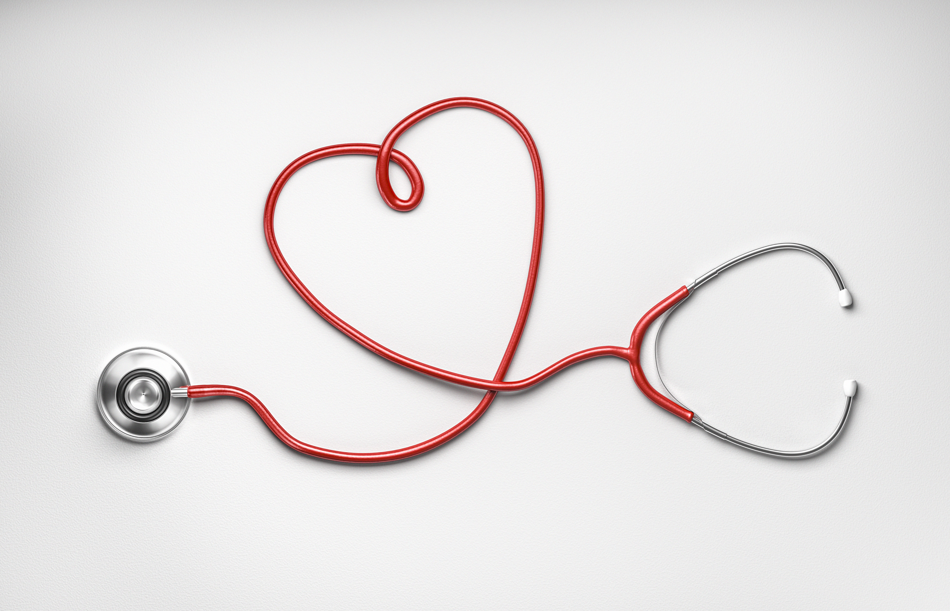
Cardiovascular-related challenges
Your clients who are elderly or with a disability often experience various complications and challenges concerning the heart.
According to the government of Victoria’s Better Health Channel, cardiovascular diseases are the leading cause of death in Australia, with 41,849 reported deaths in 2018 alone.
Work With Information About the Human Body

Slide 51
There are many factors why ageing and with disability clients are more prone to cardiovascular diseases, but the most common examples include:
Lack of physical activity (Idleness)
Ageing
Stress
Depression
Work With Information About the Human Body

Slide 52
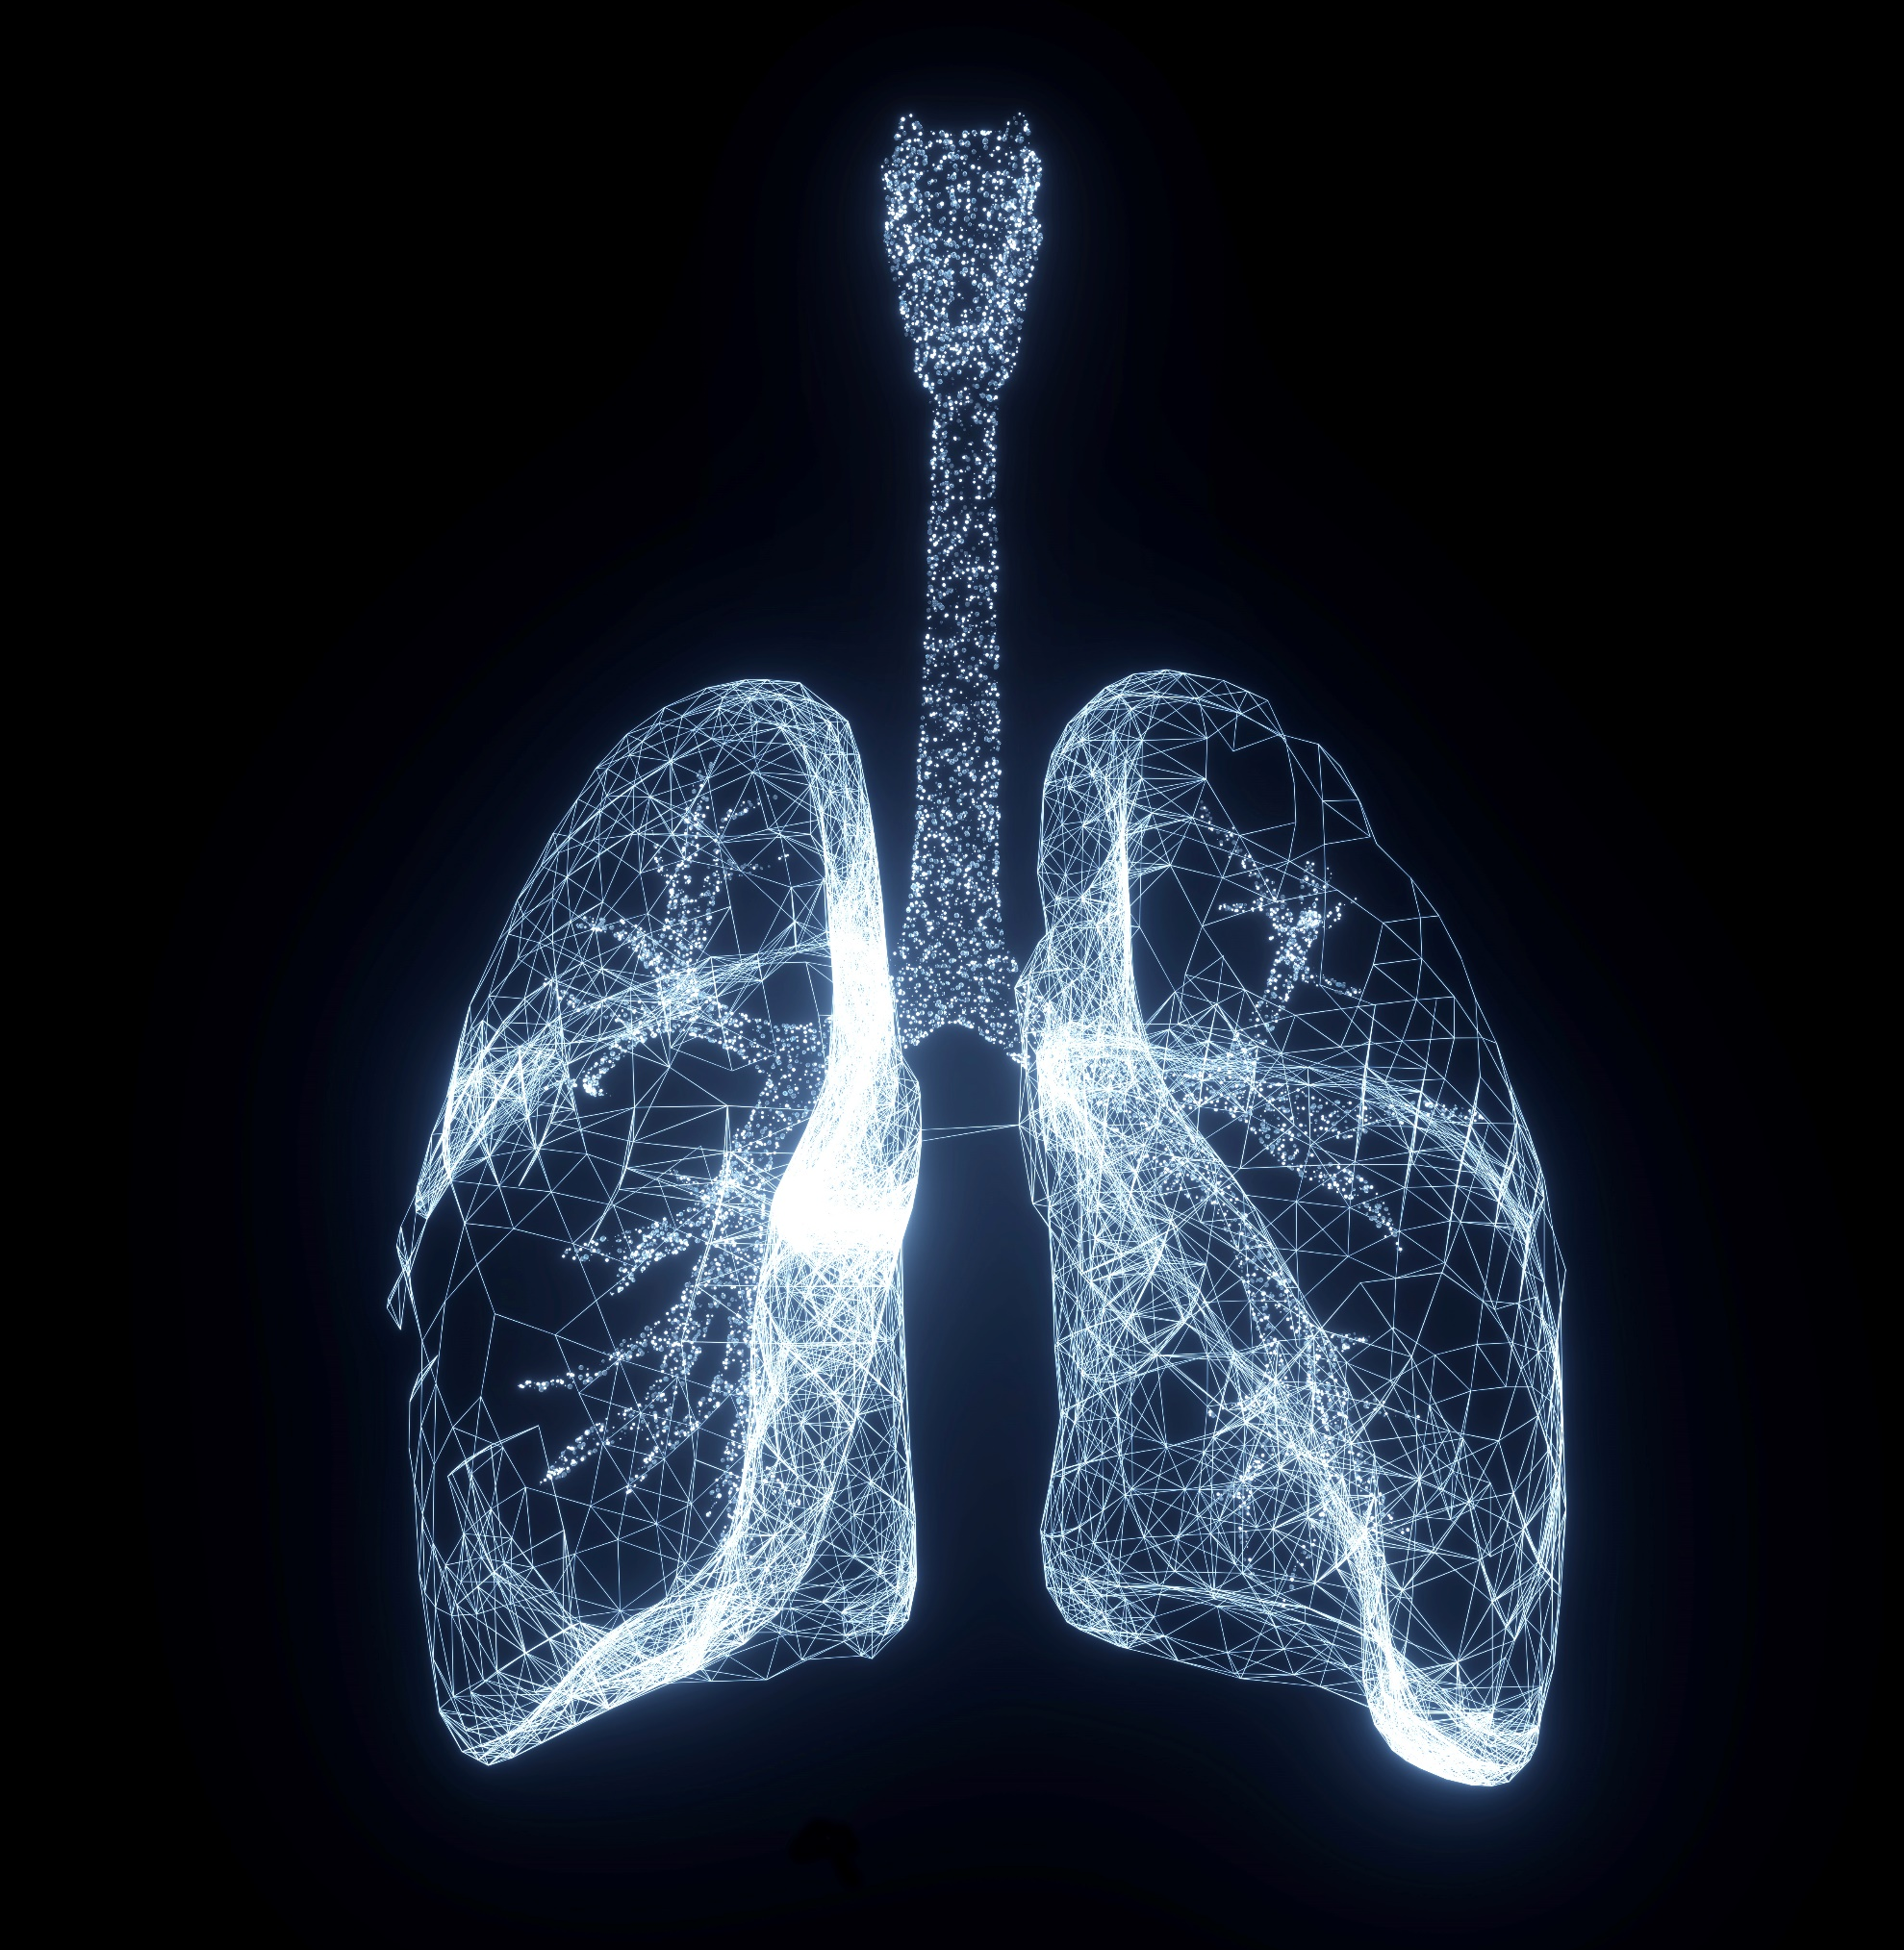
1.1.2 Respiratory System
The respiratory system is responsible for:
Bringing oxygen in and carbon dioxide out through the lungs, the nose and mouth.
Oxygen is brought into the blood through inhalation in the lungs, and carbon dioxide is brought out through exhalation.
Work With Information About the Human Body

Slide 53
Air is inhaled in through the nose and into the lungs through the following process:
Air is breathed in through the nose where it is warmed, humidified and dust is trapped.
Air then goes down the trachea and into the right and left bronchi. Then, it travels down to the right and left lungs.
In the alveoli, the oxygen is then exchanged for carbon dioxide.
Capillaries surrounding the alveoli sac are where oxygen is exchanged for carbon dioxide.
Work With Information About the Human Body

Slide 54

Air is inhaled in through the nose and into the lungs through the following process:
The diaphragm assists with breathing by drawing air into the lungs (inhalation) and releasing (exhalation) air into the lungs.
Work With Information About the Human Body

Slide 55
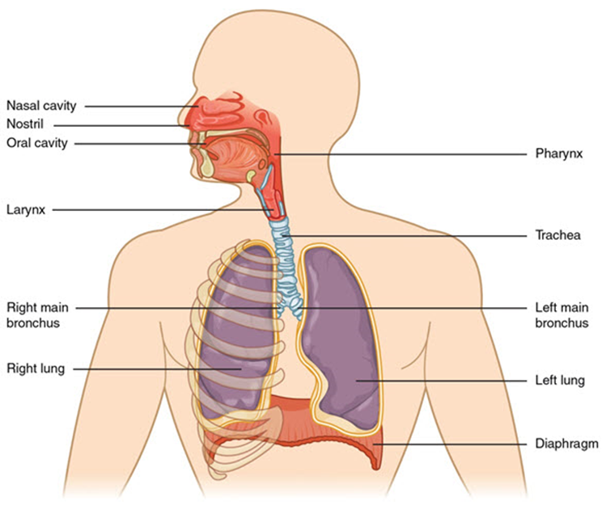
Other important terminologies to keep in mind regarding the structure, location and function of the parts of the respiratory system can be seen in this photo.
Work With Information About the Human Body

Slide 56
1.1.3 Musculoskeletal System
The musculoskeletal system is mainly responsible for giving structure and providing the body with the right amount of blood cells, and the muscular system, which facilitates movement and locomotion.
The musculoskeletal system consists of bone, muscle, joints, cartilage, ligaments (bind bone to bone) and tendons (bind muscle to bone).
Work With Information About the Human Body

Slide 57
It has the following functions:
Supports the weight of the body
Stores calcium
Produces red blood cells in the bone marrow
Protects organs
Assists with movement – movement occurs when muscles contract
Work With Information About the Human Body

Slide 58
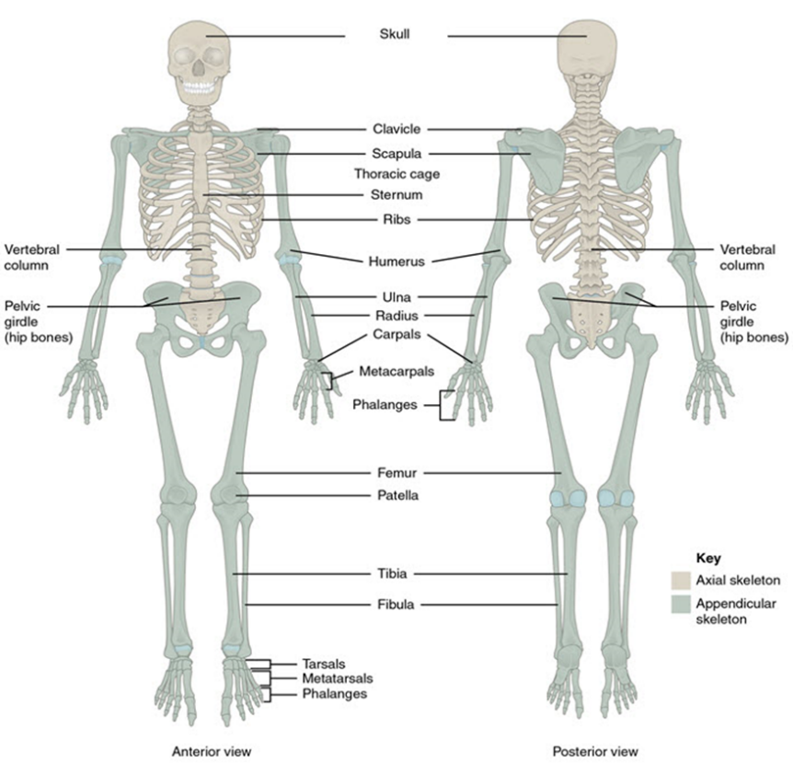
Important terminologies to keep in mind regarding the structure and location of the parts of the skeletal system can be seen in the photo:
Work With Information About the Human Body

Slide 59
There are also different muscle types, and these are:
Skeletal muscle
Supports movement and are voluntary
Cardiac muscle
Contracts and relax the heart to help pump blood around the body, and they are involuntary
Smooth muscle
Located in organs such as the intestine (peristalsis) and blood vessels
Work With Information About the Human Body

Slide 60
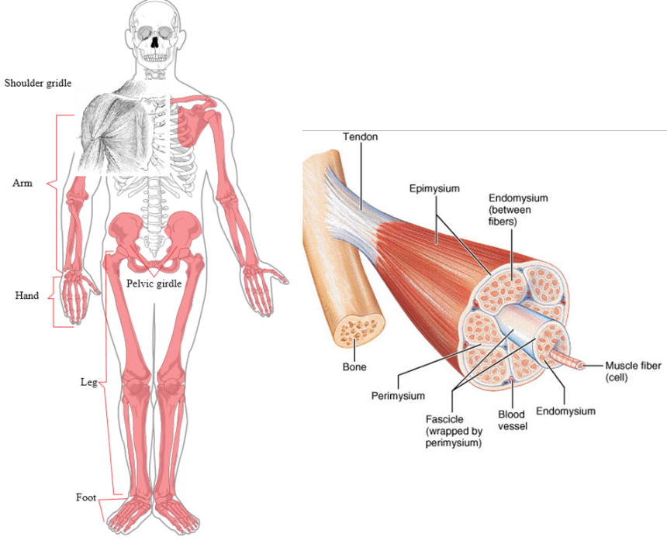
Important terminologies to keep in mind regarding the structure and location of the parts of the different muscle types can be seen in the photo:
Work With Information About the Human Body

Slide 61
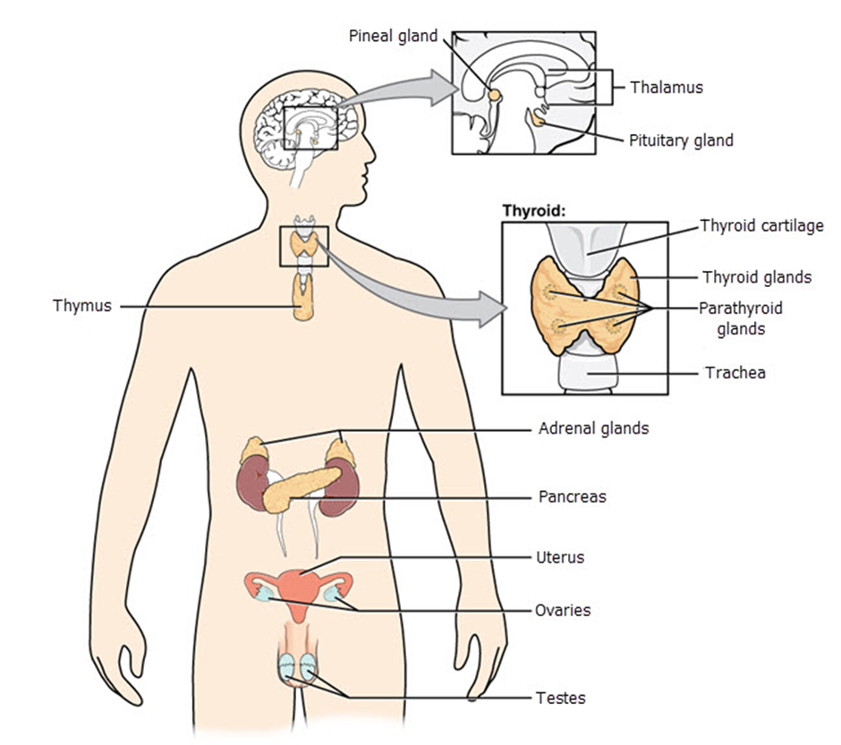
1.1.4 Endocrine System
The function of the endocrine system is to regulate growth, our moods, digestion, metabolism, tissue function and reproduction.
Work With Information About the Human Body

Slide 62
The endocrine system secretes hormones transported to the organs via the circulatory system.
Below are glands, their hormones and functions:
Pituitary gland - is connected to the hypothalamus, which is another gland that oversees many functions in the body.
Work With Information About the Human Body

Slide 63
The pituitary gland releases the following hormones:
Thyroid stimulation hormone - stimulates metabolism, which is a chemical process within cells.
Antidiuretic hormone - acts on the kidneys to stimulate the reabsorption of water if there is a reduction in blood volume. Therefore, less water is excreted in the urine.
Oxytocin - facilitates contractions during childbirth.
Prolactin - stimulates breast milk production.
Work With Information About the Human Body

Slide 64
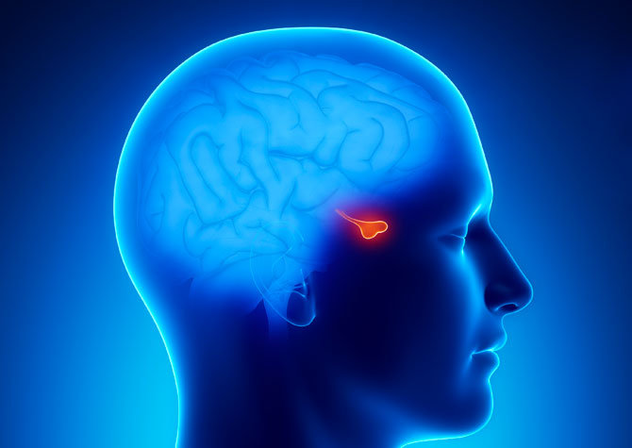
The pituitary gland releases the following hormones:
Endorphins - acts on the nervous system to produce a feeling of well-being and analgesic effect.
Work With Information About the Human Body

Slide 65
Below are other important terminologies that you will encounter in the endocrine system:
Pineal glands
Produce melatonin
Thymus
Thymosins nurture the lymphocytes (white blood cells)
Pancreas
Makes insulin (needed for glucose to enter cells and be converted to energy)
Work With Information About the Human Body

Slide 66
Below are other important terminologies that you will encounter in the endocrine system:
Adrenal glands
Adrenaline-regulates HR, blood vessel diameter and component of the ‘fight-or-flight.’
Corticosteroids- manage stress, regulate salt and water balance, reduce inflammation
Sexual glands
Oestrogen and testosterone produce gender characteristics
Work With Information About the Human Body

Slide 67
Impacts of Ageing and Disability
As people age, the endocrine system changes due to decreased hormone production.
Endocrine function normally declines with age because hormone receptors become less sensitive.
In your women clients, menopause is usually when estrogen levels decline.
In your men clients, testosterone levels normally decrease gradually.
Due to the decrease in the levels of growth hormone, there may also be decreased muscle mass and strength in an individual.
Work With Information About the Human Body

Slide 68
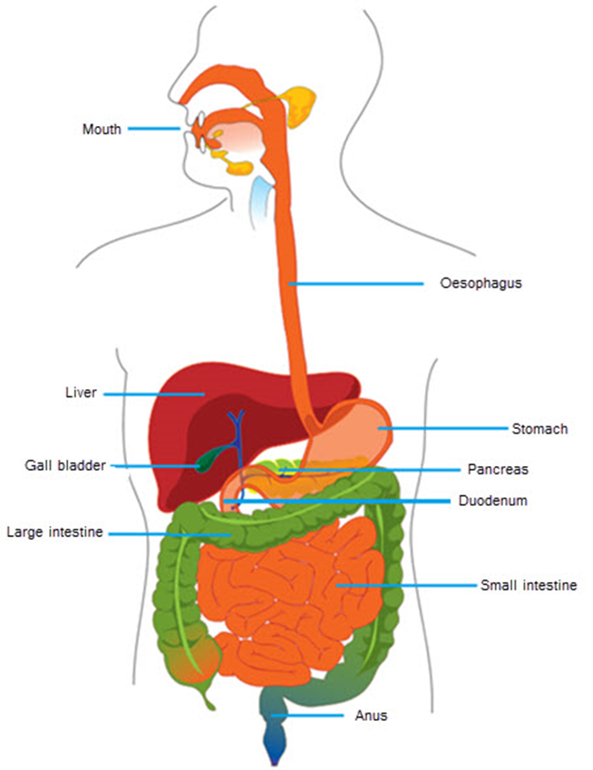
1.1.5 Digestive System
After we take food via the mouth to the stomach, our digestive system breaks food down into simple substances to be absorbed into the bloodstream via the intestines.
These simple forms become energy used by the body to aid in our growth, for fuel and repair.
Work With Information About the Human Body

Slide 69
Enzymes in the digestive system include:
Hydrochloric acid and pepsin - help to break proteins into amino acids.
Bile - helps to emulsify fats and fat-soluble vitamins.
Lipase - helps to break fats into fatty acids.
Amylases - helps to break carbohydrates (starch) into maltose.
Maltase - helps to convert maltose to glucose.
Protease - helps to break proteins into amino acids.
Work With Information About the Human Body

Slide 70
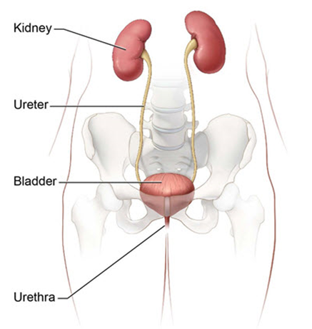
1.1.6 Urinary System
The urinary system removes liquid waste from the blood to keep a stable balance of salts and other substances in the blood.
The urinary system also eliminates waste in a process called urination.
One of the primary organs involved in this process is the kidneys.
Work With Information About the Human Body

Slide 71
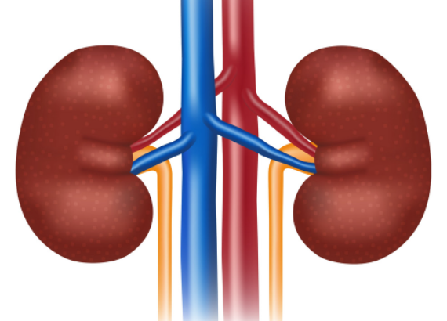
The main functions of the kidneys are to:
Remove wastes
Maintain homeostasis
Regulate PH level
Produce hormones
Calcitriol
Erythropoietin
Renin
Work With Information About the Human Body

Slide 72
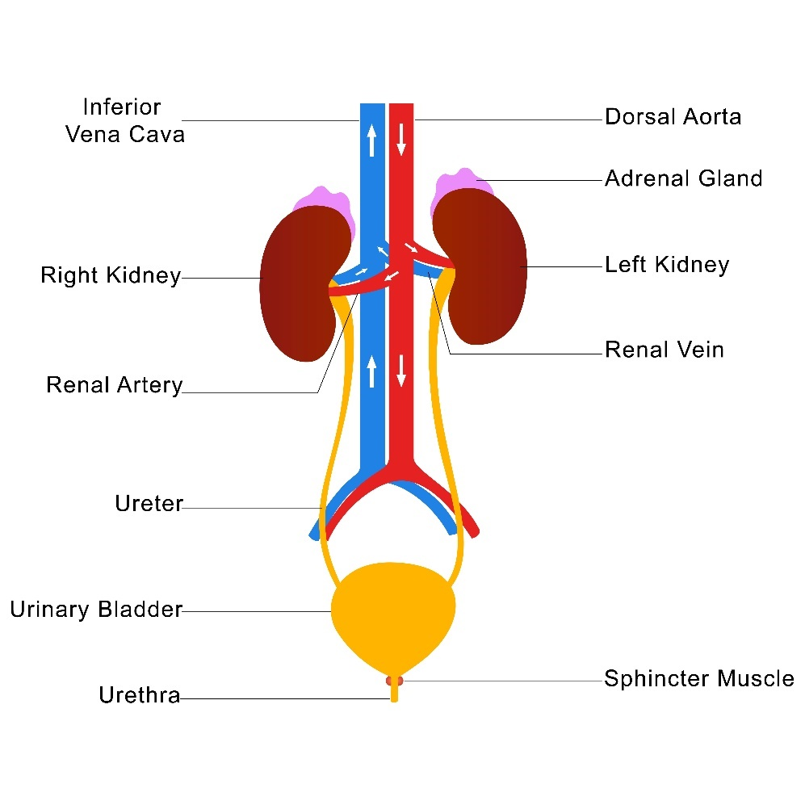
Renal System
The urinary system is also called the renal system.
The renal system refers more to the renal arteries, inferior vena cava, dorsal aorta and sphincter muscle.
They help the kidneys filter and regulate blood and excrete wastes through urine.
Work With Information About the Human Body

Slide 73
Each part in the renal system performs a critical function which includes:
Dorsal aorta - the vein that gives rise to many intersegmental arteries. These arteries transfer oxygenated blood to the segmented muscles and form the renal arteries to the kidneys.
Inferior vena cava - the vein that carries oxygen-poor blood from the legs, feet and organs in the abdomen and pelvis to go to the heart. From the heart, the blood goes to the lungs until it gets distributed to other parts of the body.
Work With Information About the Human Body

Slide 74
Each part in the renal system performs a critical function which includes:
Adrenal gland - produces the aldosterone. It sends signals to the kidneys to absorb more sodium into the bloodstream and release potassium in the urine. This results in homeostasis.
Urethral sphincter- it controls the exit of urine from the body. It contracts to prevent urine from leaving the bladder. It relaxes to allow urine to flow to the urethra.
Work With Information About the Human Body

Slide 75
1.1.7 Reproductive System
The reproductive system is essential in the procreation of life.
It involves:
Male Reproductive System
Female Reproductive System
Work With Information About the Human Body

Slide 76
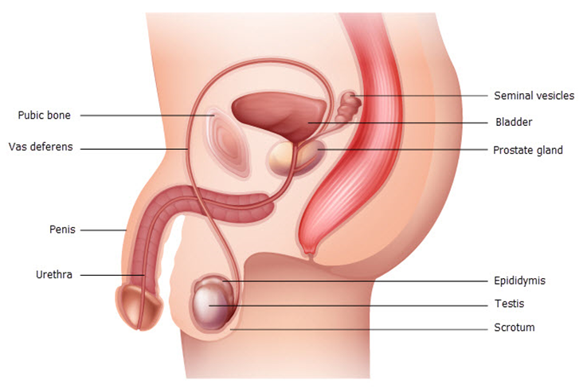
Male Reproductive System
The male reproductive system is comprised of the following parts:
Work With Information About the Human Body

Slide 77
They are normally comprised of external and internal organs. The internal organs include:
Vas deferens - transports mature sperm to the urethra in preparation for ejaculation
Ejaculatory ducts - empties into the urethra.
Urethra - carries urine from the bladder to outside of your body. It also has the function of expelling (ejaculating) semen.
Seminal vesicles - attached to the vas deferens near the base of the bladder. It provides sperm with a source of energy and helps with the sperms’ ability to move.
Work With Information About the Human Body

Slide 78
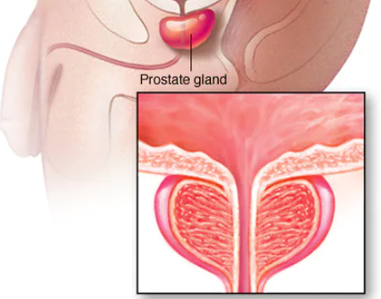
They are normally comprised of external and internal organs. The internal organs include:
Prostate gland - contributes additional fluid to the ejaculate.
Work With Information About the Human Body

Slide 79
They are normally comprised of external and internal organs. The internal organs include:
Penis - male organ for sexual intercourse and an important organ which plays a role in secreting urine.
Scrotum - holds the testicles (also called testes), as well as many nerves and blood vessels.
Testicles (testes) - responsible for making testosterone, the primary male sex hormone, and for producing sperm.
Work With Information About the Human Body

Slide 80
Female Reproductive System
The female reproductive system is comprised of external and internal organs.
The external organs include:
Labia majora - enclose and protect the other external reproductive organs
Labia minora - surrounds the openings to the vagina and urethra.
Clitoris - sensitive protrusion that is comparable to the penis in males
Work With Information About the Human Body

Slide 81
The internal organs include:
Vagina - a canal that joins the cervix to the outside of the body
Uterus - the home to a developing fetus
Ovaries - produce eggs and hormones
Fallopian tubes - narrow tubes where fertilization of an egg (ova) by a sperm normally occurs
Work With Information About the Human Body

Slide 82
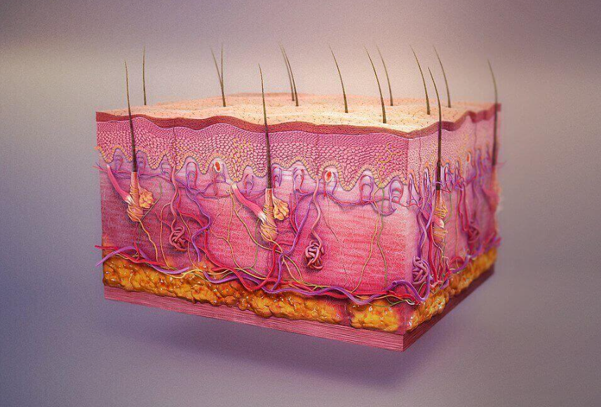
1.1.8 Integumentary System
The integumentary system is mainly responsible for protecting the internal parts of the body and serves as defense against bacteria, pollution, and harmful UV rays from the sun.
This is also the largest organ of the body and consists of skin, hair, nails and exocrine glands.
Work With Information About the Human Body

Slide 83
The skin has three layers, and these include:
Epidermis - produces melanin which contributes to skin colour.
Dermis - contains nerve endings, hair follicles, sweat glands, sebaceous glands and blood vessels.
Fat layer - serves as a protective padding and insulates the body from cold and hot.
Work With Information About the Human Body

Slide 84
The skin’s other functions include:
Protecting the body from dehydration.
Eliminating waste such as salts, water, urea and lactic acid.
Regulating the temperature by evaporating sweat (when hot) and vasodilation (when cold).
Protecting the body from infectious microorganisms.
Producing of vitamin D.
Signaling the brain for sensations such as pain, touch, pressure, cold and heat.
Work With Information About the Human Body

Slide 85
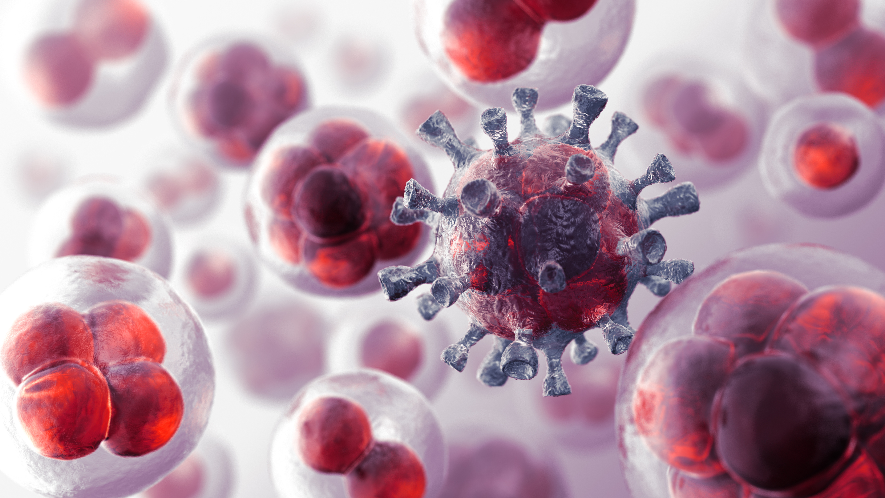
1.1.9 Lymphatic System
The lymphatic system transports fluid containing infection-fighting white blood cells throughout the body.
There are lymphatic vessels throughout organs in the body, with lymph nodes located along with the system.
Work With Information About the Human Body

Slide 86
The lymphatic system removes excess interstitial fluid and drains the fluid into the circulatory system, absorbs fats via the villi in the small intestine and helps fight infection.
Lymph vessels are located throughout the body and carry clear straw-coloured fluid (lymph) and white blood cells (lymphocytes).
Lymph nodes are round, soft, and located throughout the body, such as the armpit, groin, and neck. They contain lymphocytes which filter bacteria, cancer cells and other foreign substances from the body.
Work With Information About the Human Body

Slide 87
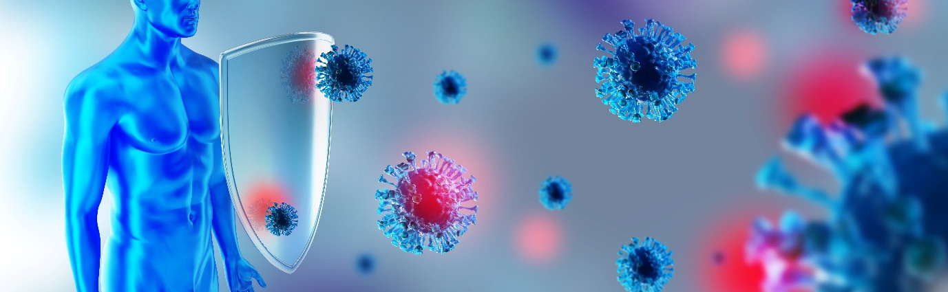
The lymphatic system includes:
Tonsils - traps germs before they enter the breathing passage.
Spleen - destroys damaged and old cells.
Thymus - helps produce WBC
Liver - produces a large amount of lymph, which is estimated to be 25 to 50 % of lymph flowing through the thoracic duct
Work With Information About the Human Body

Slide 88
The major organs and systems in the lymphatic system that are mainly involved in protecting the body from infections include:
Keratin, a protein inside skin cells, makes up the skin cells and, along with other proteins, sticks together to form the epidermis.
The epidermis keeps bacteria and germs from entering the body and causing infections.
White blood cells attach to germs, absorbing them or destroying them. They produce antibodies that latch onto these germs.
Work With Information About the Human Body

Slide 89
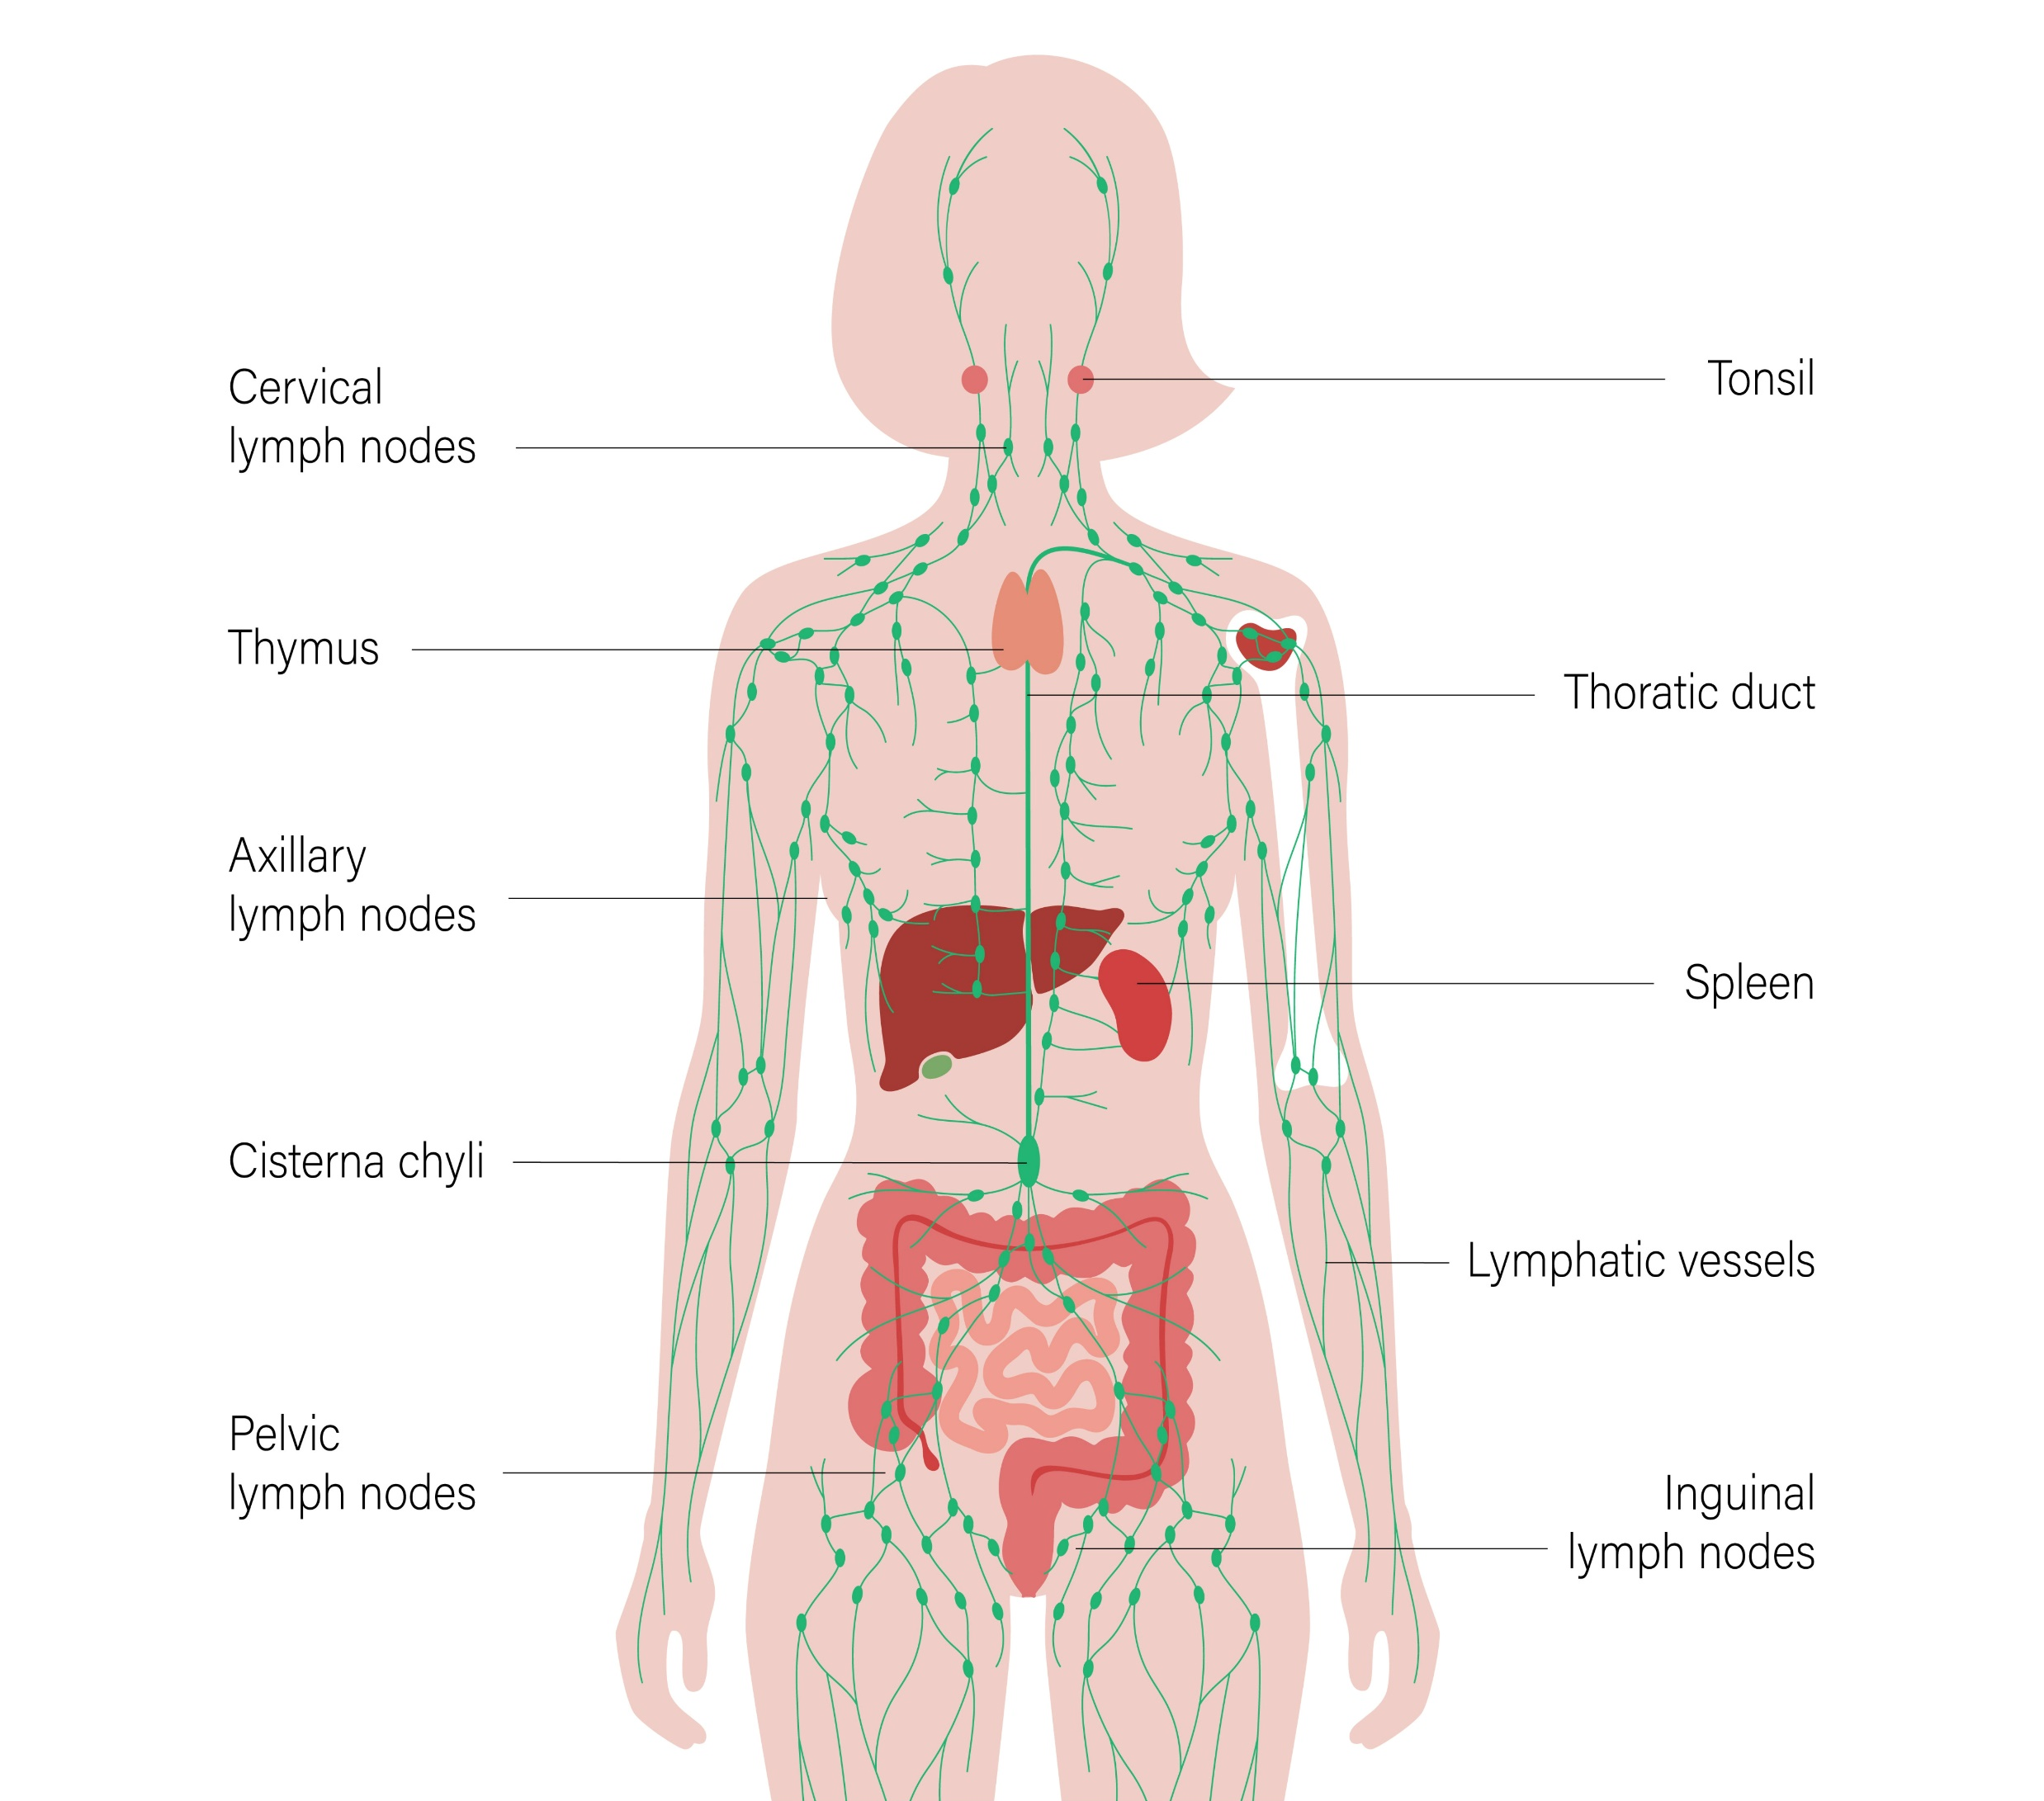
The lymphatic system is also a part of the immune system.
The immune system provides the body protection from infections and diseases.
Work With Information About the Human Body

Slide 90
1.1.10 Immune System
The immune system is pivotal in our overall wellness.
It functions in the background and is silently waiting for any opportunity to protect your body from getting ill.
If all is well, you will not even be aware it is there.
But you will get ill, if it stops working properly.
Understanding the immune system structure and function can help you make informed choices to improve the health and wellness of your clients.
Work With Information About the Human Body

Slide 91
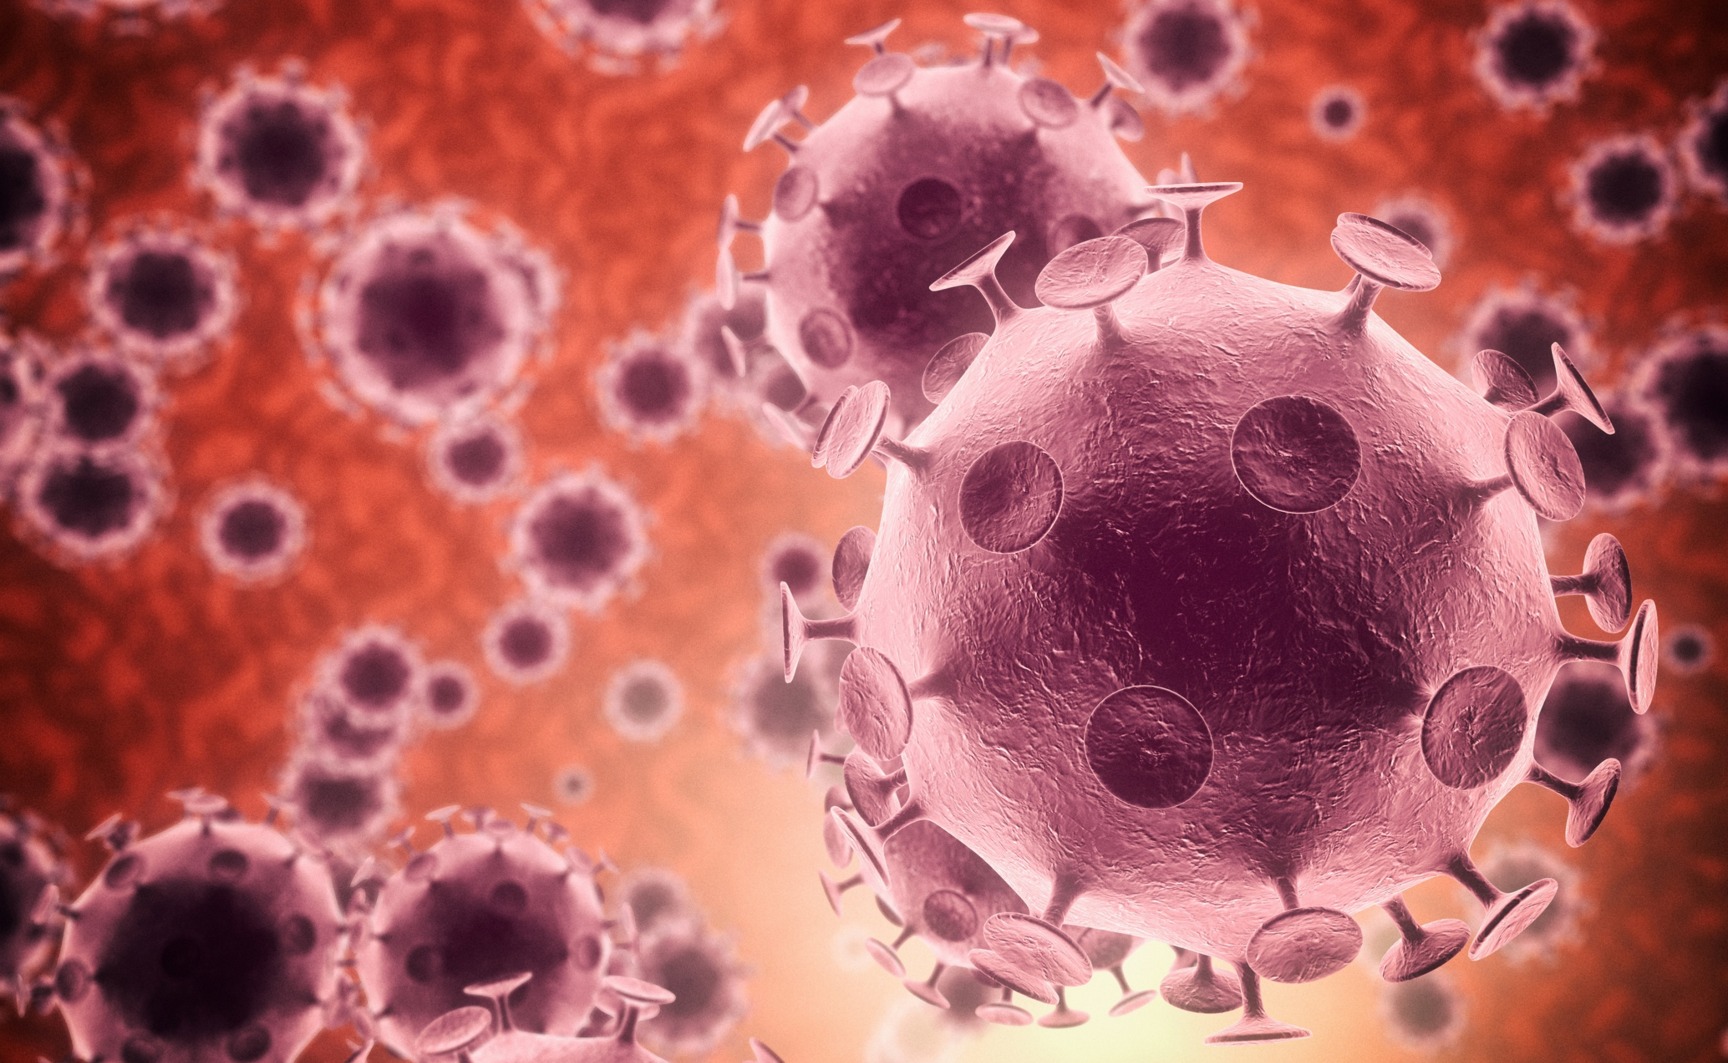
The immune system is mainly responsible for:
Fighting intruders such as bacteria, viruses, parasites or fungi
Recognising and neutralising harmful substances from our surroundings
Fighting internal changes within the body that causes illnesses, such as cancer cells
Work With Information About the Human Body

Slide 92
Organs Of the Immune System
Among the many organs that function under the immune system, a few can be considered pivotal in the overall function of the immune system.
Bone marrow
Lymph nodes
Thymus gland
Spleen
Work With Information About the Human Body

Slide 93
Below are the organs considered pivotal in the operations of the immune system and how they contribute to keeping the body from illnesses.
Bone Marrow
Pertains to the spongy substance in the cavities of bones, in which blood cells, such as the red blood cells and platelets and the white blood cells are produced.
Work With Information About the Human Body

Slide 94
Below are the organs considered pivotal in the operations of the immune system and how they contribute to keeping the body from illnesses.
Lymph Nodes
Lymph nodes are masses of tissue located along lymphatic system pathways which include the following body parts:
The groin
Armpits
Below the chin
Abdomen
Chest
Work With Information About the Human Body

Slide 95
Below are the organs considered pivotal in the operations of the immune system and how they contribute to keeping the body from illnesses.
Thymus Gland
Is located behind the sternum. It also plays a role in the production of white blood cells called lymphocytes which help the body fight infection.
Spleen
Filters your blood as it breaks down and removes abnormal, old or damaged cells.
Work With Information About the Human Body

Slide 96
The common diagnoses relevant to the immune system that you will likely encounter in your line of work, include:
Leukemia
Cancer of the blood, in which the bone marrow makes abnormal white blood cells
Infection
Infection may cause swollen lymph nodes
Work With Information About the Human Body

Slide 97
The common diagnoses relevant to the immune system that you will likely encounter in your line of work, include:
Aplastic Anemia
Tumors may block lymphatic ducts or even metastasise to lymph nodes
The bone marrow doesn’t make red blood cells
Cancer
Work With Information About the Human Body

Slide 98
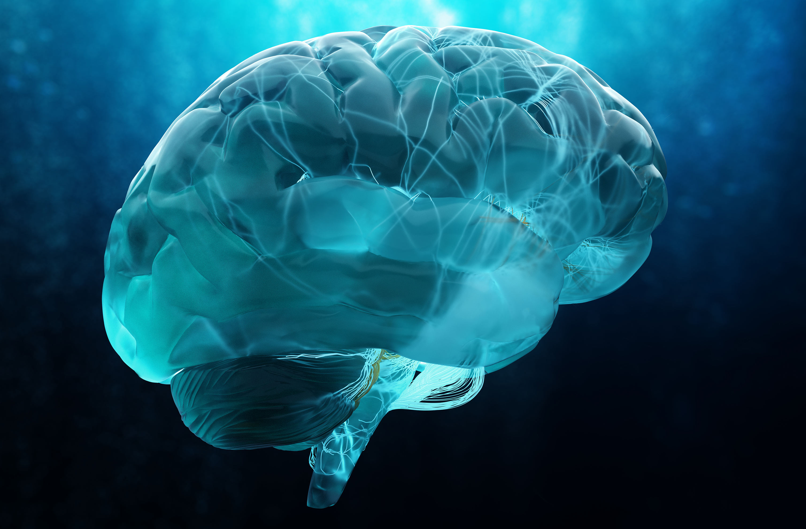
1.1.11 Nervous System
The nervous system is in charge of communication of the body with its other parts by carrying information from the brain to other parts of the body.
Work With Information About the Human Body

Slide 99
The nervous system consists of the following:
Central nervous system (CNS) - this is the command center of the body. It consists of:
The brain - The central control point for the nervous system.
The spinal cord - Links the brain and the peripheral nervous system (PNS)
The retinas of the eyes - A thin layer of tissue positioned at the back of the eye inside.
Work With Information About the Human Body

Slide 100
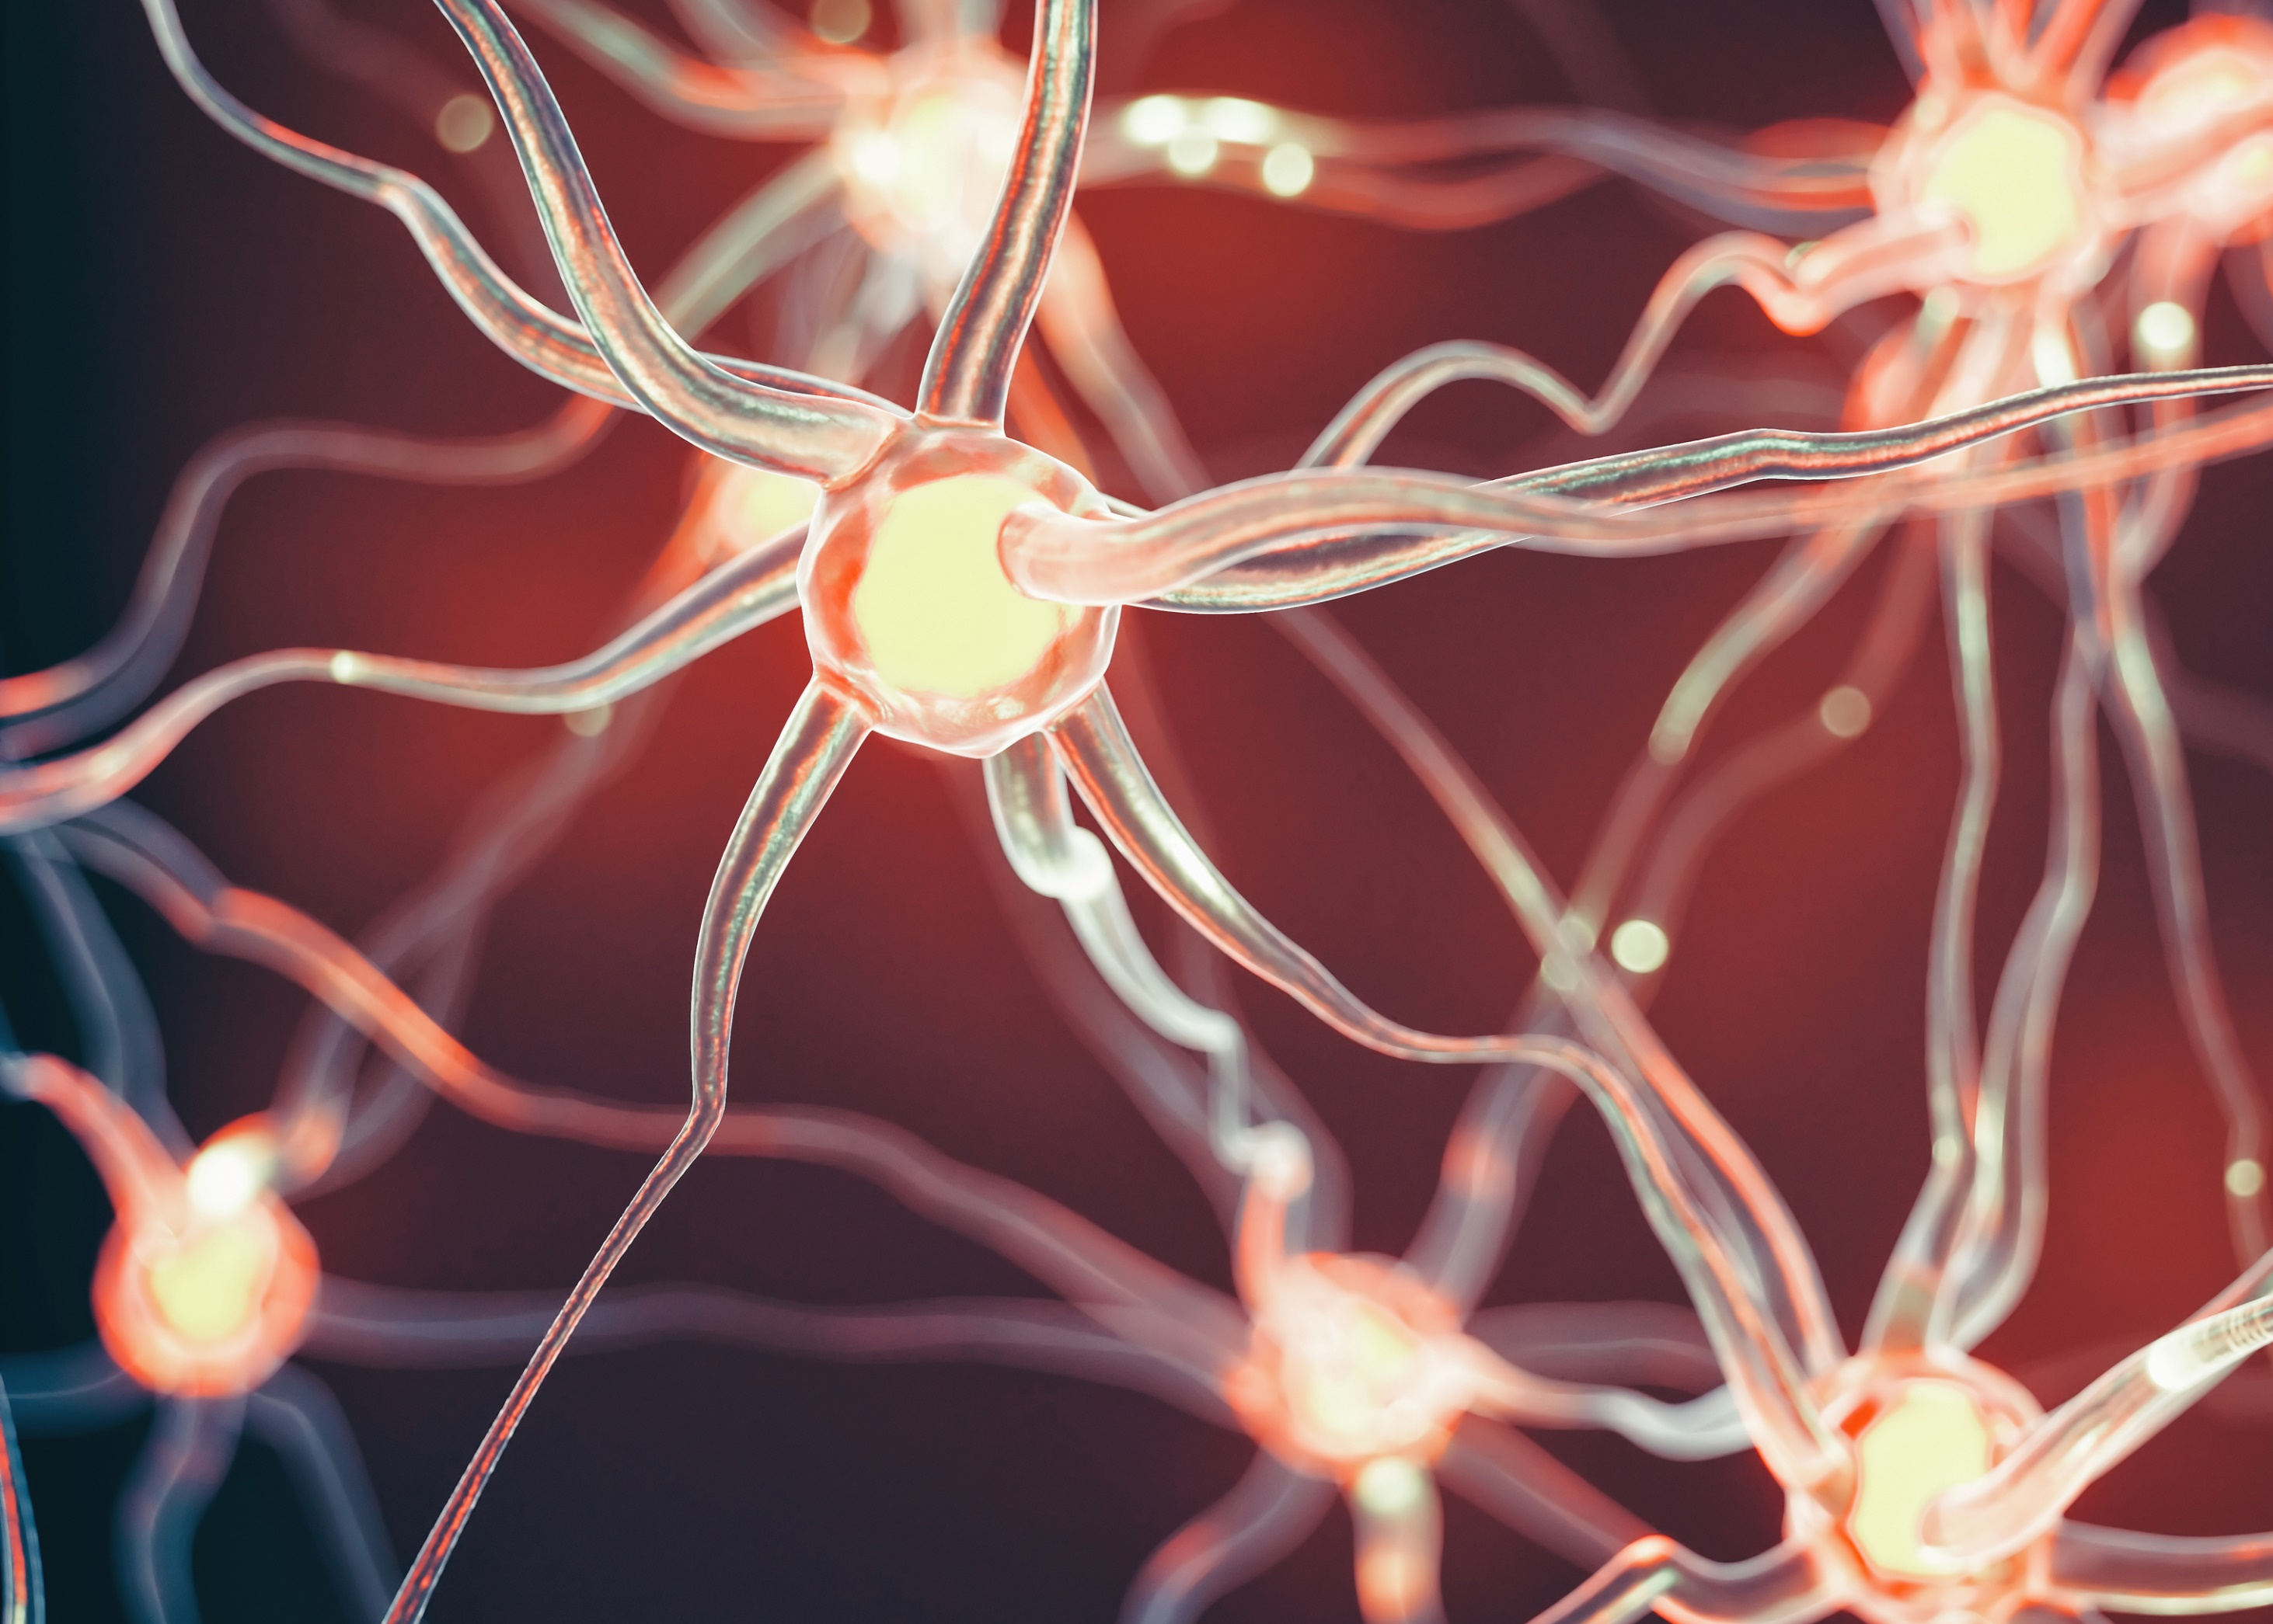
The nervous system consists of the following:
Peripheral nervous systems (PNS) - involves nerve cells (neurons) located outside the central nervous system.
Work With Information About the Human Body

Slide 101
There are different types of neurons (nerve cells), and these include:
Sensory neurons, e.g. neurons in the skin which detect temperature, pain and pressure.
Motor neurons which stimulate the muscles.
Interneurons which connect all neurons.
Work With Information About the Human Body

Slide 102
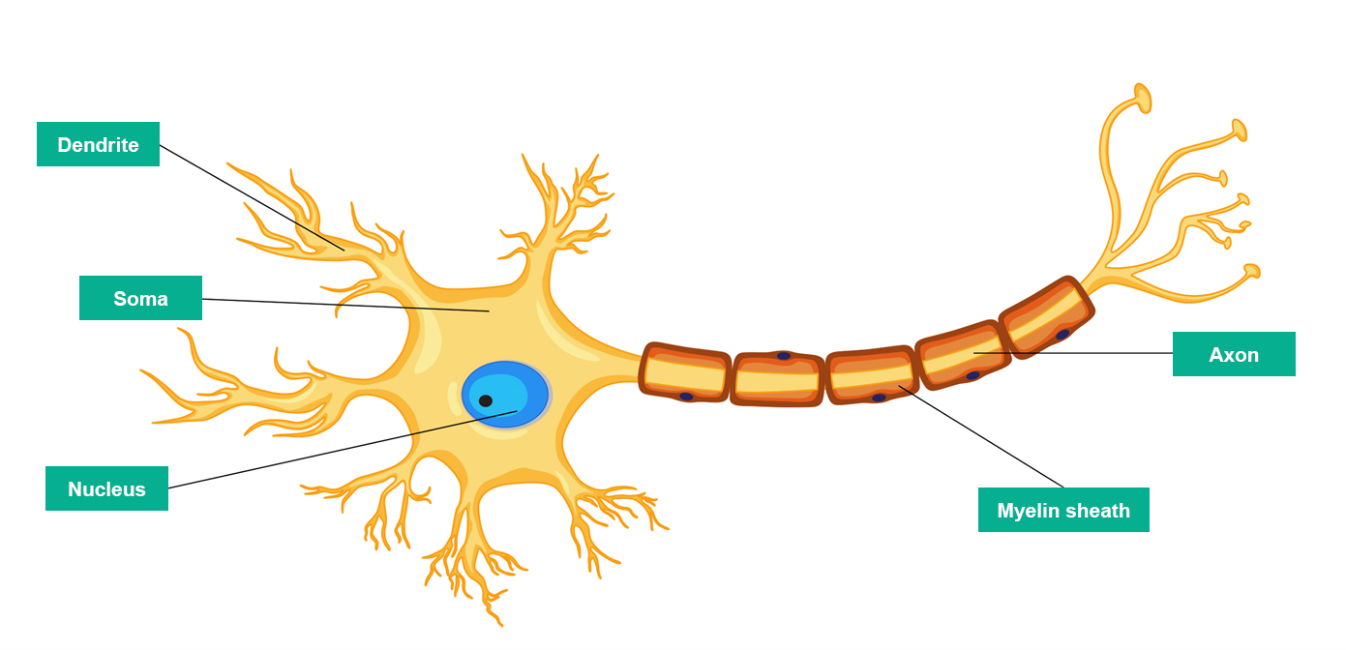
To help you understand how the brain receives and interprets information, take note of the following terminologies and functions of the different parts of the nervous system.
Work With Information About the Human Body

Slide 103
A nerve cell is composed of the following parts:
Dendrite - the structures that looks like a branch found at the ends of the neuron which receives signals or information from other neurons.
Soma - the body of the cell where the nucleus lies, and which controls the cells.
Nucleus - the part of the cell which stores DNA, which helps with and controls a cell’s function, growth and reproduction.
Work With Information About the Human Body

Slide 104
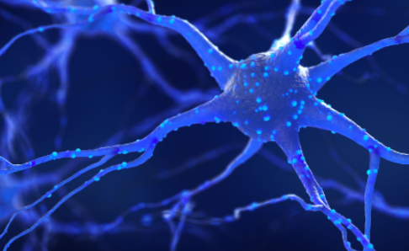
A nerve cell is composed of the following parts:
Axon - the long extension structure from the soma. It works to transmit information it receives down its body to the dendrites at the end of the neuron.
Myelin sheath - the protective sleeve that covers the axon of neurons.
Work With Information About the Human Body

Slide 105
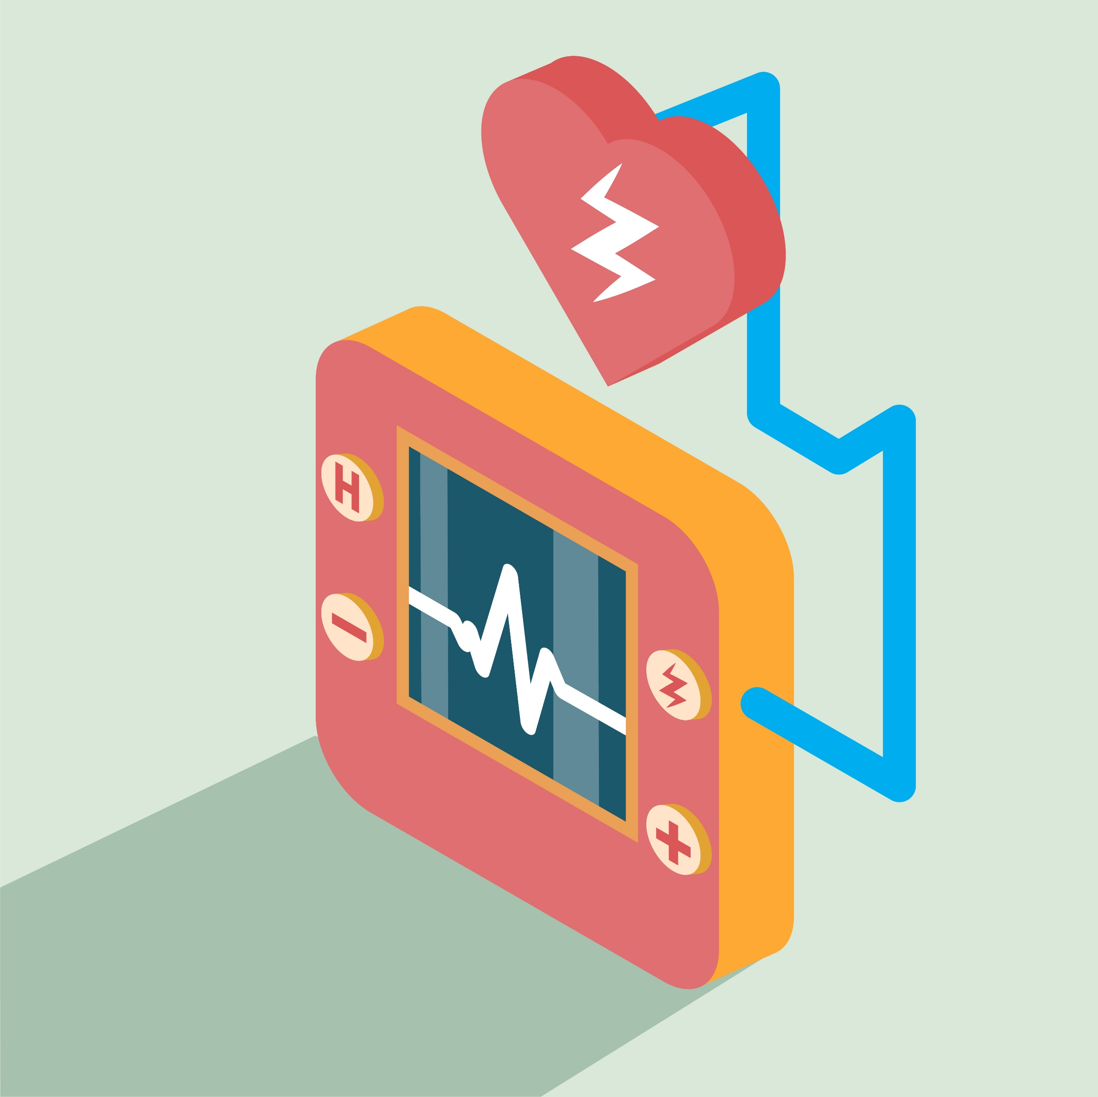
The somatic system (or voluntary nervous system) sends sensory information to the central nervous system then a message is sent to motor nerve fibres.
The autonomic system is responsible for involuntary actions like breathing and heart rate.
Work With Information About the Human Body

Slide 106
Eyes and Ears
The eyes and the ears are two components of the body that share a close relationship with the nervous system although they are external body parts.
Eyes
Receives, focuses, and transmits light that helps us see (vision)
Ears
Receives sound waves (hearing)
Maintains balance (equilibrium)
Work With Information About the Human Body

Slide 107
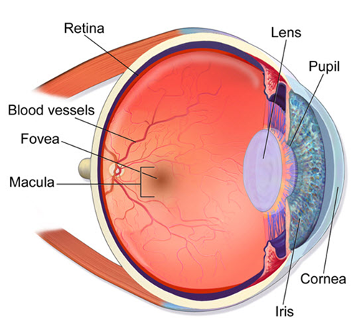
The parts of the eyes are as follows:
Work With Information About the Human Body

Slide 108
1.1.12 Senses of the Body
The special senses include the functions of the organs such as the nose, tongue, eyes and ears.
The eyes and ears have already been discussed earlier.
Now, it is time to read about how they function in conjunction with other organ systems such as the nervous system.
Work With Information About the Human Body

Slide 109
The eyes and the ears play a vital role in the way people interpret the things around them.
The senses and functions that are associated with the eyes and ears are the following:
Vision
Hearing
Equilibrium
Work With Information About the Human Body

Slide 110
The other sensory organs include:
Tongue
Helps in tasting
Chewing
Swallowing food
Speech
Work With Information About the Human Body

Slide 111
The other sensory organs include:
Nose
Allows air to enter the body
Primary organ for smelling
Filters debris
Work With Information About the Human Body

Slide 112

1.2
Interpret Information Relevant to the Interrelationship of Body Structures

Slide 113
The human body is made up of a complex structure of systems that all work together.
The heart, which is part of our circulatory system, does not pump blood unless our brain, which functions under the nervous system, tells it to.
The endocrine system coordinates with the other organ systems by releasing hormones that function as chemical signals.
The muscular system will not function if the respiratory and circulatory systems do not supply it with oxygen and nutrients.
Work With Information About the Human Body

Slide 114

It takes all the organ systems to work together for a human being to be alive and live well. Each organ system has different tasks to perform.
You need to know how each of the body’s organ systems is interrelated with each other to maximise any plans of improving and supporting your client’s health overall.
Work With Information About the Human Body

Slide 115
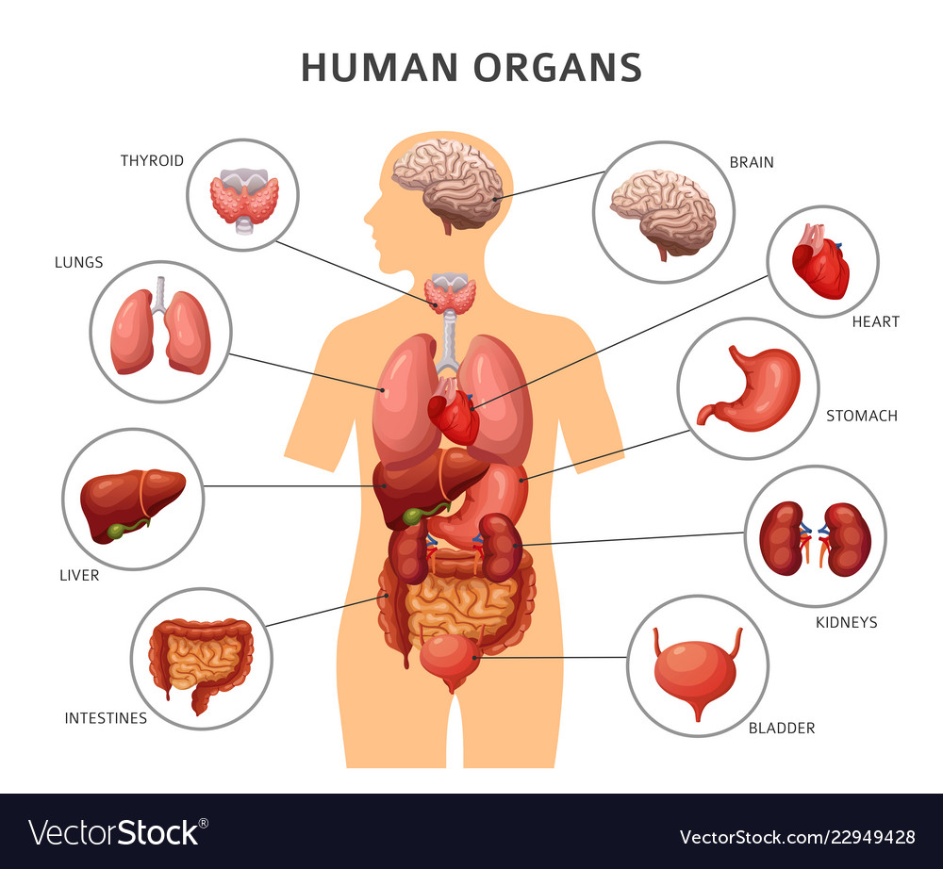
Not knowing how basic organ systems interconnect with each other can lead to grave consequences, including:
Confusion with interpretation
Injuries
Expensive mistakes
Medical malpractice
Loss of life
Work With Information About the Human Body

Slide 116
1.2.1 Interrelated Major Organ Systems and Relevant Common Body System Issues
No organ systems works in isolation.
You must recognise how the body is structured and how it functions to work as a single unit.
The wellbeing of your client depends upon all the interacting organ systems.
A problem within one system generally has consequences for several other organ systems.
This is even more important and true in your work role as you work with the elderly and people with disability.
Work With Information About the Human Body

Slide 117
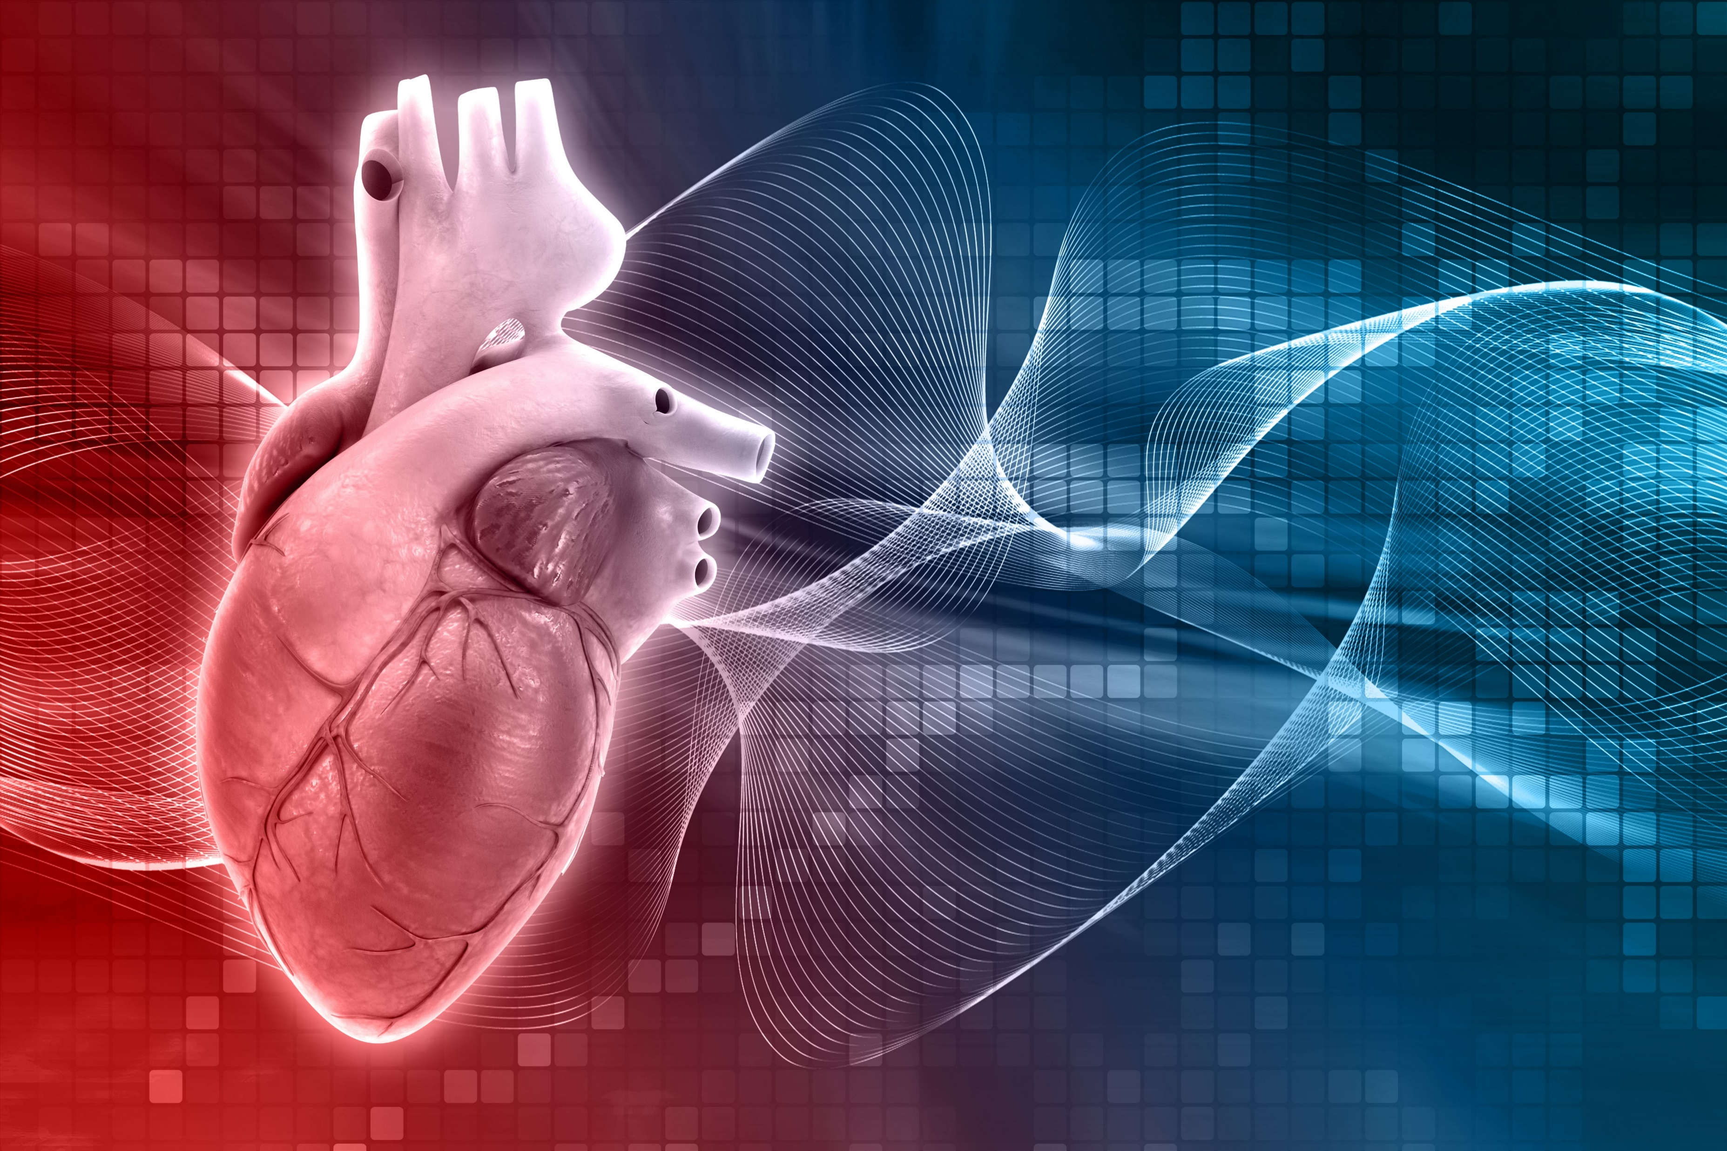
Cardiovascular System’s Relationship with Other Organ Systems
One major organ system that is a perfect example of how all the organs are interrelated is the cardiovascular system.
Work With Information About the Human Body

Slide 118
Here are some of the notable ways the cardiovascular system interacts with the other organs to help the body function:
Cardiovascular System and Respiration
The circulatory and respiratory systems work together to circulate blood and oxygen throughout the body.
Air goes in and out of the lungs through the trachea, bronchi, and bronchioles.
Work With Information About the Human Body

Slide 119
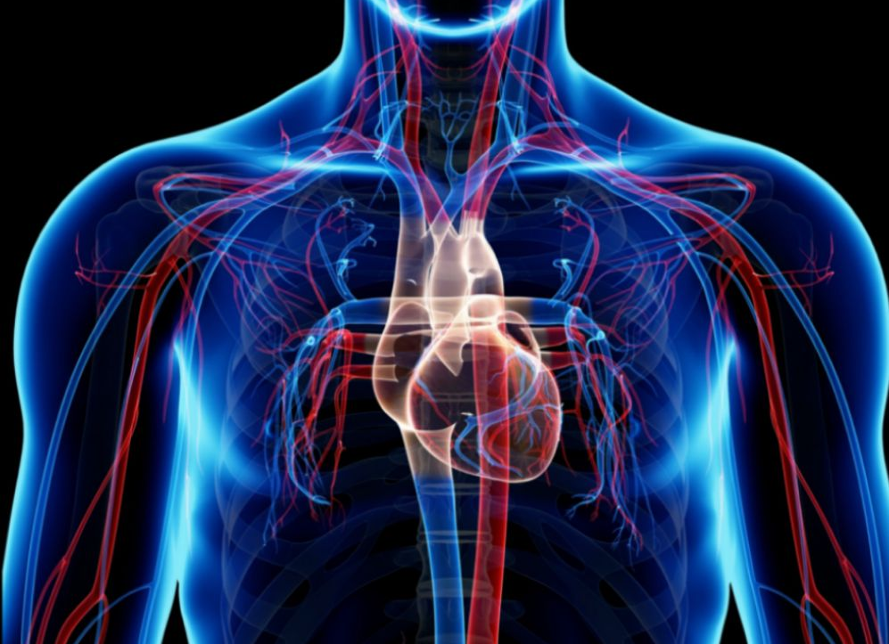
Here are some of the notable ways the cardiovascular system interacts with the other organs to help the body function:
Cardiovascular System and Respiration
Then blood moves in and out of the lungs through the pulmonary arteries and veins that connect to the heart.
Work With Information About the Human Body

Slide 120
Here are some of the notable ways the cardiovascular system interacts with the other organs to help the body function:
Cardiovascular System and Immunity
The bone marrow found within the interior walls of bones is crucial for the proper development of the immune system.
Most blood cells are made in the bone marrow.
Work With Information About the Human Body

Slide 121
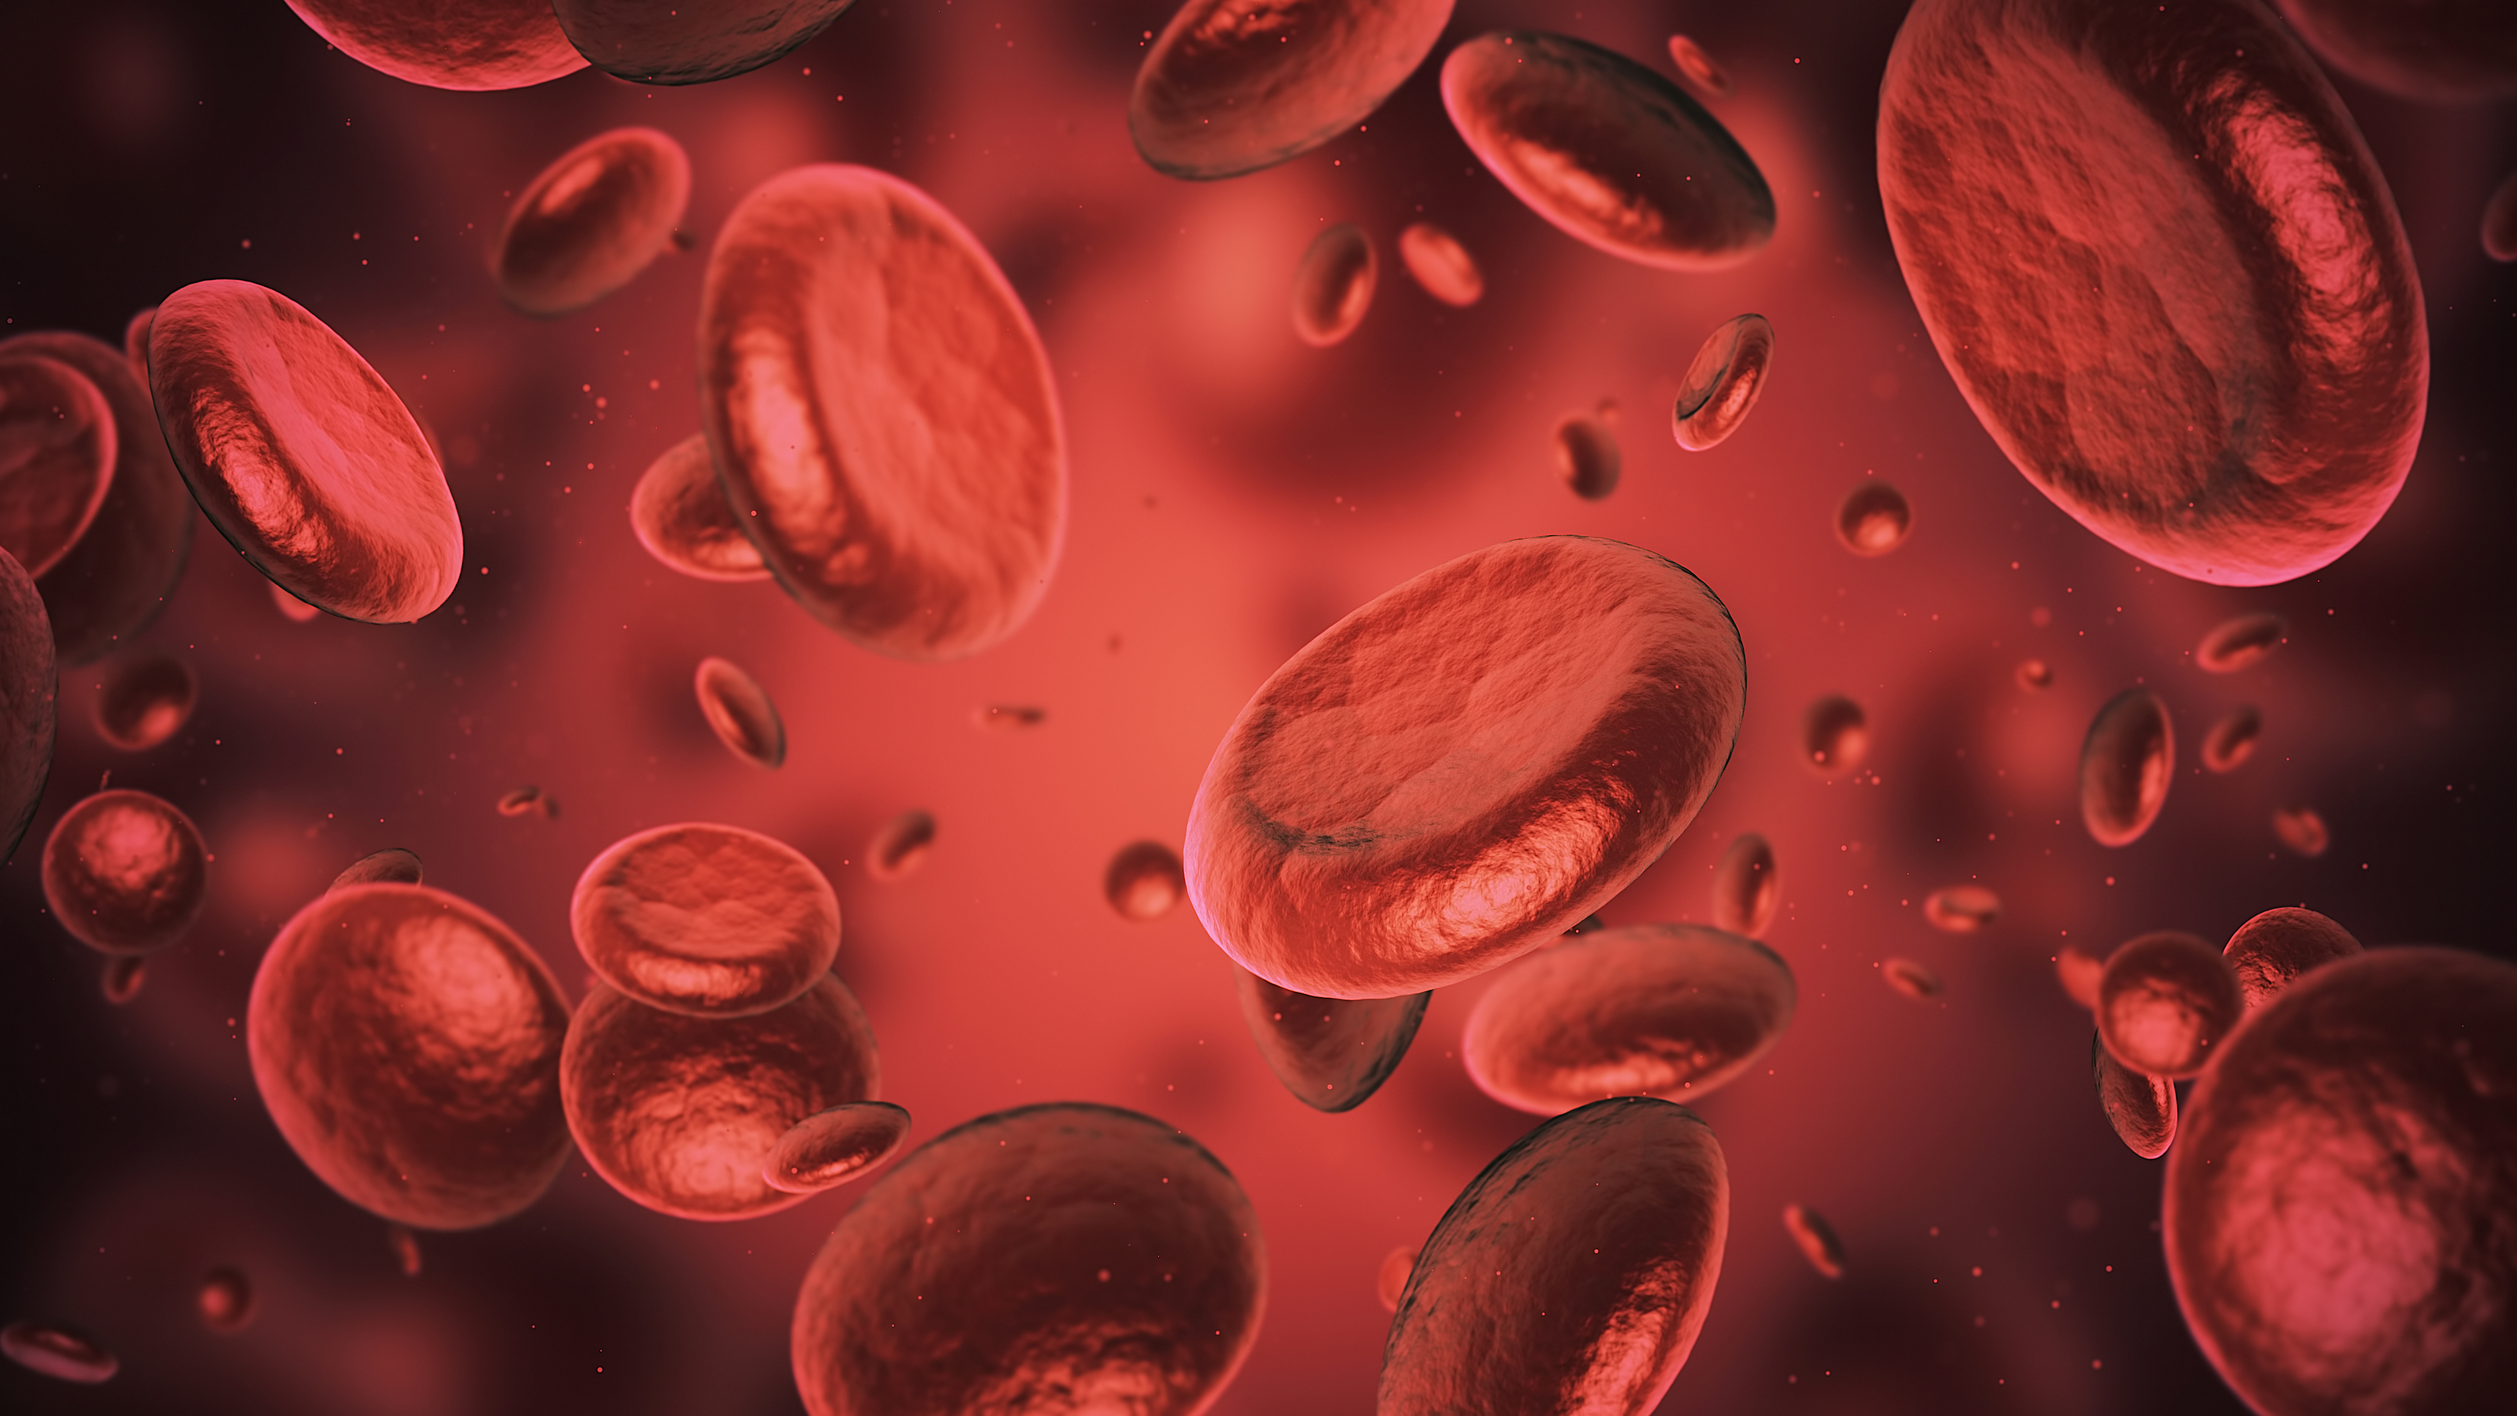
Here are some of the notable ways the cardiovascular system interacts with the other organs to help the body function:
Cardiovascular System and Immunity
The blood cells produced in the bone marrow, such as the white blood cells, are the ones that fight of intruders in the body to prevent infections.
Work With Information About the Human Body

Slide 122
Here are some of the notable ways the cardiovascular system interacts with the other organs to help the body function:
Cardiovascular System and Digestion
The circulatory system helps distribute the nutrients absorbed in the digestive system.
This is completed with the help of the blood which carries the nutrients such as sugars and essential acids absorbed and processed by the liver.
Work With Information About the Human Body

Slide 123
The notable ways the cardiovascular system interacts with the other organs to help the body function:
Cardiovascular System and the Urinary System
The urinary system helps the blood be cleansed of waste products and extra water. It helps in controlling blood pressure, making red blood cells and keeping the balance of minerals in the blood.
Work With Information About the Human Body

Slide 124
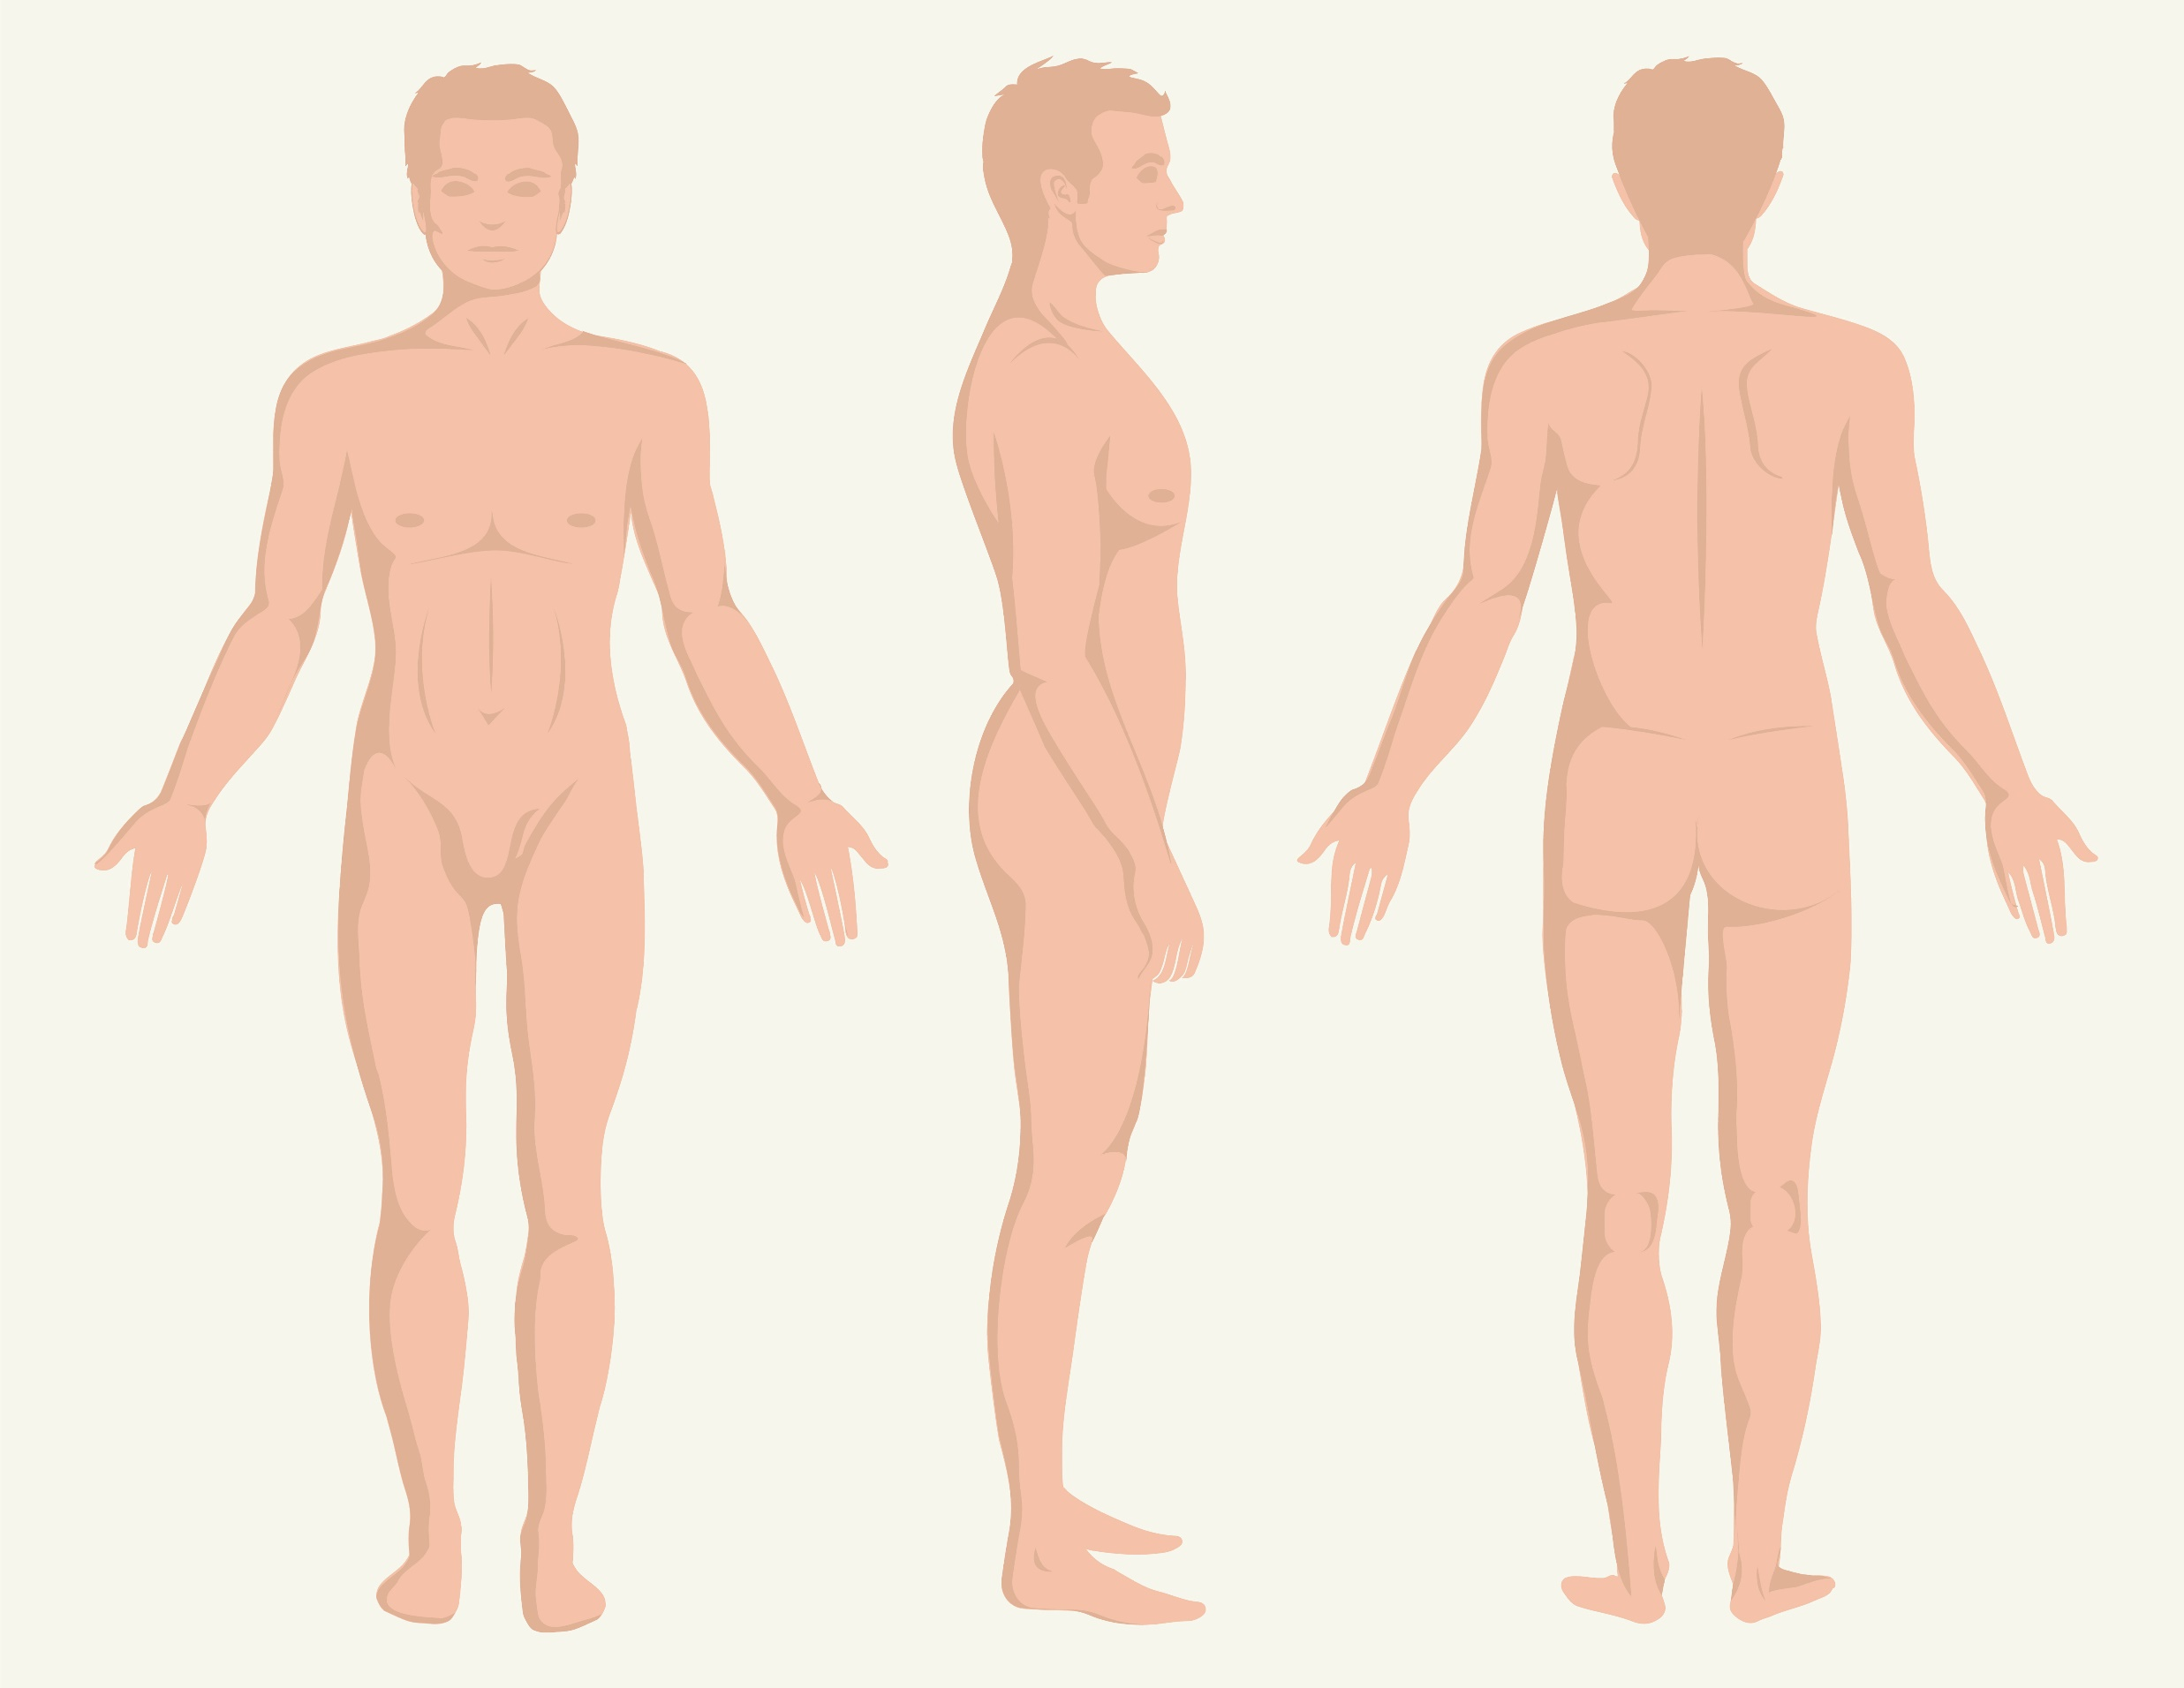
Other Major Organ Systems’ Relationship with the Rest of the Organ Systems
Since the interrelationship of the major body organs is complex and involves many great body systems such that the body functions at its best.
Work With Information About the Human Body

Slide 125
Below are the other notable ways the other major systems interact with the other organs to help the body function:
Lymphatic system and Immune system
The lymphatic system is an important part of the immune system.
It produces and releases white blood cells and other immune cells that monitor and then destroy the foreign invaders
Work With Information About the Human Body

Slide 126
Below are the other notable ways the other major systems interact with the other organs to help the body function:
Digestive and Excretory Systems
The food processed by the stomach are broken down to be used by the body's cells and tissues with the help of the stomach's enzymes
Work With Information About the Human Body

Slide 127

Below are the other notable ways the other major systems interact with the other organs to help the body function:
Endocrine and Nervous Systems
The endocrine and nervous systems are linked through the hypothalamus. This organ controls human behaviour, including emotional and stress responses.
Work With Information About the Human Body

Slide 128
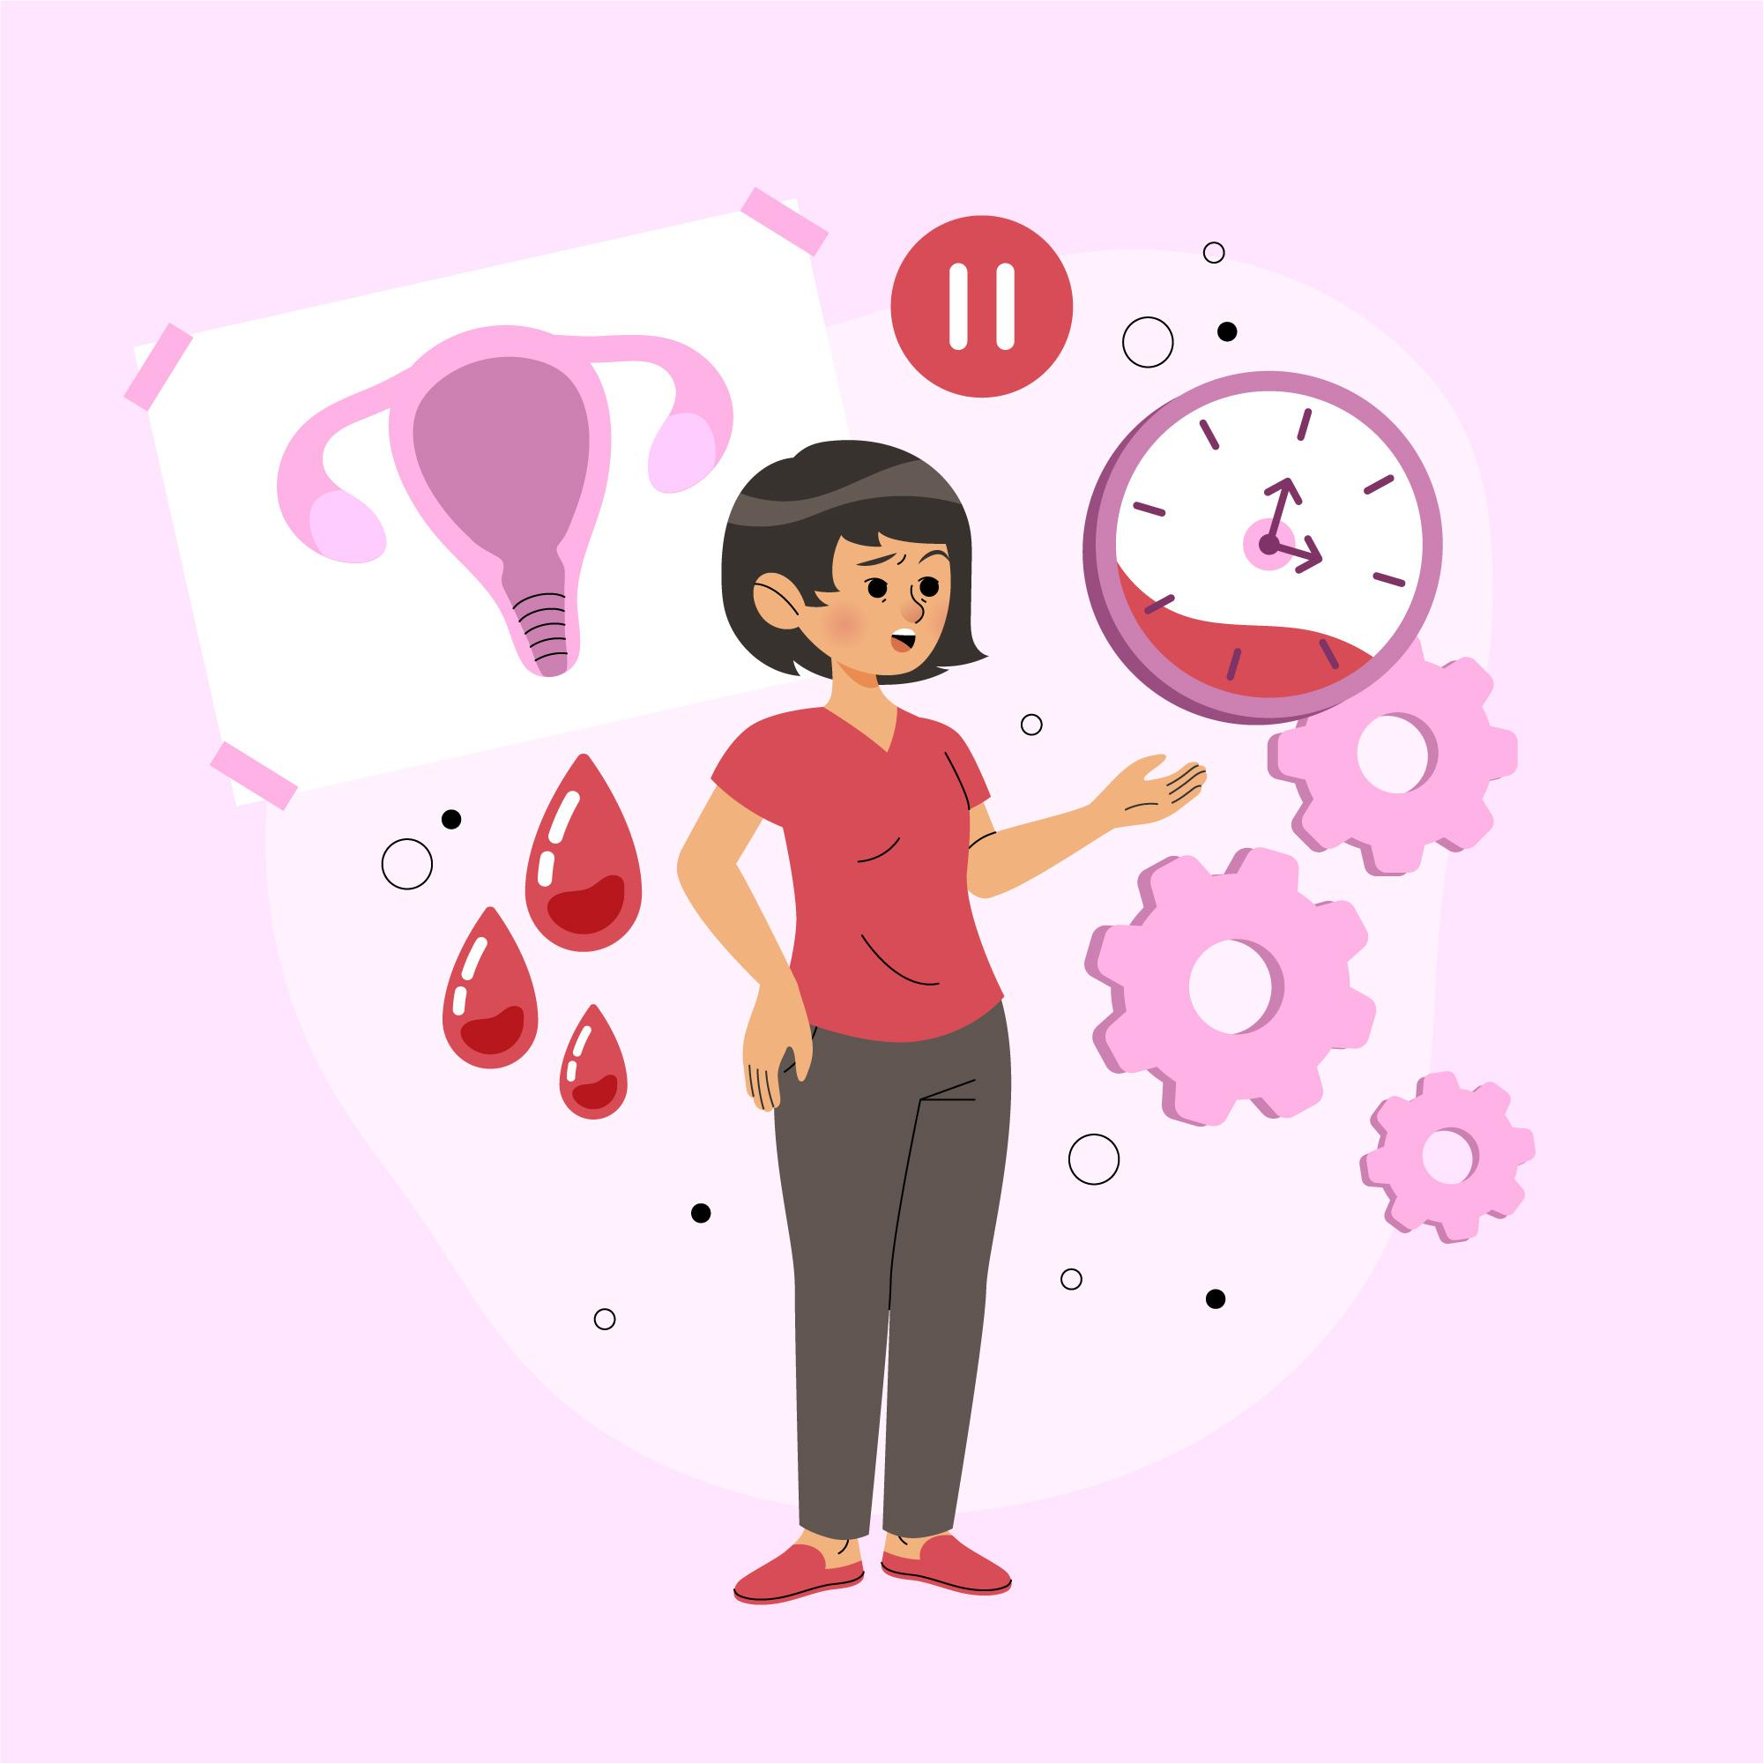
Below are the other notable ways the other major systems interact with the other organs to help the body function:
Endocrine and Reproductive Systems
The endocrine glands in the reproductive system produce sex hormones that are responsible for secondary sex characteristics in men and women.
Work With Information About the Human Body

Slide 129
Below are the other notable ways the other major systems interact with the other organs to help the body function:
Integumentary and Nervous System
The skin has different types of sensory receptors that receive different sensations from the environment.
These sensations are sent to and processed by the nervous system.
Work With Information About the Human Body

Slide 130
Below are the other notable ways other major systems interact with the other organs to help the body function:
Nervous and Muscular Systems
The system that provides your body's shape is the skeletal system, and it is made up of cartilage and bone.
Movement in the body results from muscle contraction; when muscles combine with the action of joints and bones, obvious movements are performed, such as jumping and walking.
Work With Information About the Human Body

Slide 131
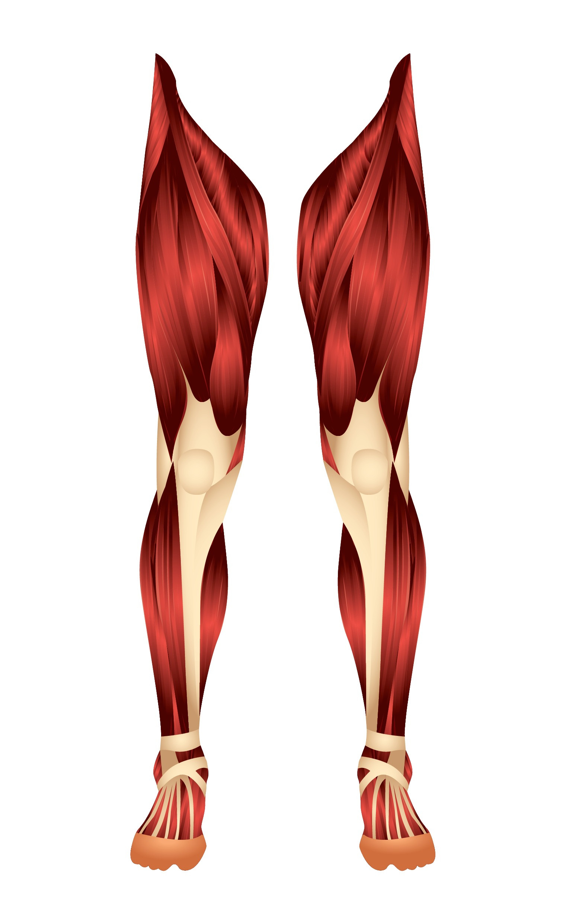
Below are the other notable ways the other major systems interact with the other organs to help the body function:
Nervous and Muscular Systems
The contraction of muscles provides the body posture, joint stability and heat production. The nervous system controls voluntary muscle movements.
Work With Information About the Human Body

Slide 132
Impacts of Ageing and Disability on Client’s Wellbeing
World Health Organization (WHO) explains that ageing results from the accumulation of a wide variety of molecular and cellular damage over time.
Like an ageing person’s body, people with disability’s bodies’ molecular and cellular structure changes, and an ageing body will experience a decline in its physical and mental capacity.
Work With Information About the Human Body

Slide 133
To perform your work role properly, you must first understand what ageing and disability does to the body.
Ageing and specific disabilities affect various areas of life.
This includes the following:
Physical wellbeing
Psychological wellbeing
Mental health wellbeing
Work With Information About the Human Body

Slide 134
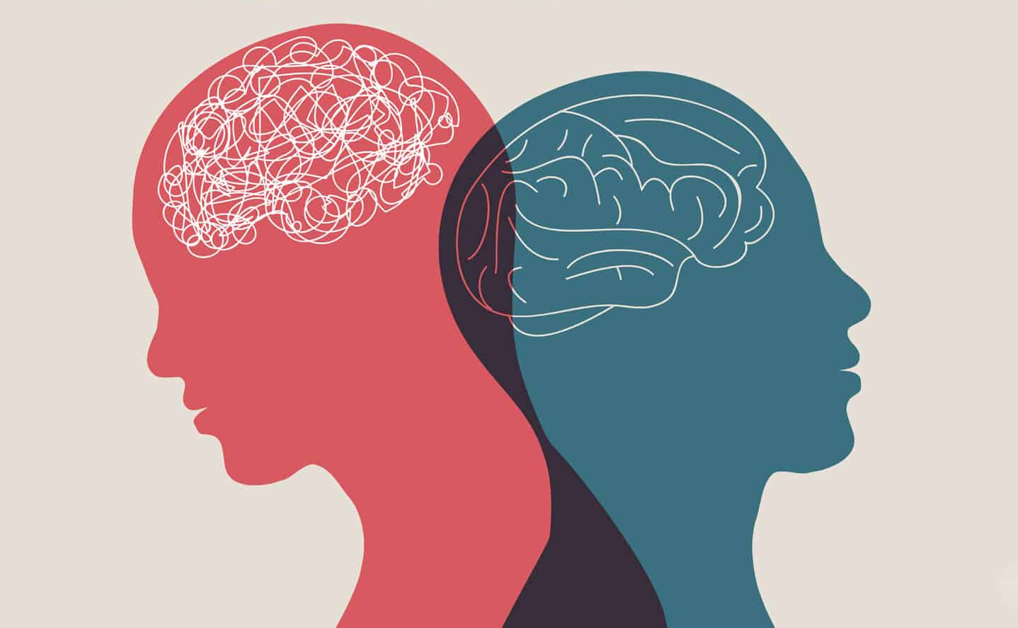
Psychological and mental are terms that may be used interchangeably to describe similar issues.
However, these terms are often used in different ways and may affect how your client with specific issues will be treated.
Work With Information About the Human Body

Slide 135
Mental health condition related issues are identified based on experience and observation of a variety of symptoms that results in a psychiatric diagnosis.
On the other hand, psychological related problems are clinician-formulated-hypotheses founded on symptoms shown by the client.
Work With Information About the Human Body

Slide 136

Consideration on social and environmental factors affecting the patient are the following:
Impact on physical wellbeing
Impact on psychological (emotional) wellbeing
Impact on mental wellbeing
Work With Information About the Human Body

Slide 137

Using Knowledge About Body Systems to Monitor Client’s Health and Physical Condition
As a support worker, your main work responsibility is to monitor your client’s physical and overall health condition.
Work With Information About the Human Body

Slide 138

Any problems with their health, may it be with regards to their physical and psychological health and overall wellbeing, will manifest in changes in:
Their behaviour
Their appearance (e.g. Appearance of their eyes, nails, skin)
Their mobility or overall performance
Work With Information About the Human Body

Slide 139
As you monitor your client and observe these changes regarding their body, your main work responsibilities may include:
Ensuring any changes to your client's physical and psychological condition and wellbeing are documented in a progress notes
Watching out for and reporting and documenting changes in the client's condition and care needs to the supervisor
Work With Information About the Human Body

Slide 140
Now that you are familiar with the structures, functions and interactions of the organ systems in the human body, you will be able to use these information to actively recognise any changes in your client’s health.
Monitoring your client’s overall health and wellbeing often requires these necessary activities to ensure your clients wellbeing is given importance and care.
Work With Information About the Human Body

Slide 141
Your work responsibilities entail the following:
Recognising
Reporting
Documenting
Work With Information About the Human Body

Slide 142
Recognising Changes
You will be closely monitoring the following when recognising the change:
Physical changes
Mood changes
Work With Information About the Human Body

Slide 143

Report physical, emotional and mental condition changes to the supervisor, registered nurse, or doctor so they can ascertain if changes are normal or not. Some emergency indicators to report include:
Bleeding that will not stop
Coughing up or vomiting blood
Fast breathing or trouble breathing
Work With Information About the Human Body

Slide 144
1.2.2 Common Body System Issues
The following are body system issues commonly experienced by your clients:
Area | Indicators of issues
Continence and bowel health issues | Increased fluid excretion at night Soft stools Sphincter weakness
Malnutrition | Feeling weak or tired Unplanned weight loss Eating only a small amounts of food at a time
Work With Information About the Human Body

Slide 145
The following are body system issues commonly experienced by your clients:
Area | Indicators of issues
Dehydration | Not urinating frequently Dry, sticky mouth Unexplained tiredness Dark coloured urine
Work With Information About the Human Body

Slide 146
The following are body system issues commonly experienced by your clients:
Area | Indicators of issues
Weight regulation | Unplanned weight loss Constipation Loss of appetite
Oral health | Dental infections, caries or periodontitis Tooth ache Bad breath
Work With Information About the Human Body

Slide 147
The following are body system issues commonly experienced by your clients:
Area | Indicators of issues
Appetite regulation | Refusing to eat or having no desire to eat, not feeling hungry at all Experiencing unintentional or unplanned weight loss
Work With Information About the Human Body

Slide 148
The following are body system issues commonly experienced by your clients:
Area | Indicators of issues
Dysphagia | Pain while swallowing or inability to swallow Regurgitation Drooling Hoarseness
Work With Information About the Human Body

Slide 149
The following are body system issues commonly experienced by your clients:
Area | Indicators of issues
Bone health issues | Back pain Stooped posture Bone breaking more easily than expected Loss of height overtime
Work With Information About the Human Body

Slide 150
The following are body system issues commonly experienced by your clients:
Area | Indicators of issues
Food intolerance | Nausea Gas Cramps Bloating Stomach pain
Work With Information About the Human Body

Slide 151
The following are body system issues commonly experienced by your clients:
Area | Indicators of issues
Skin integrity | Rashes Bed sores Wounds from prolonged sitting or lying down Sustaining pressure injuries and cuts due to pressure on thinning skin around an area where a bone may be protruding
Work With Information About the Human Body

Slide 152
The following are body system issues commonly experienced by your clients:
Area | Indicators of issues
Dementia | Increasing confusion or poor judgement Greater memory loss Significant personality and behaviour changes Wandering
Work With Information About the Human Body

Slide 153
The following are body system issues commonly experienced by your clients:
Area | Indicators of issues
Cognitive changes | Forgetting things more often Losing train of thought Trouble speaking coherently Starting to have trouble finding their way around familiar environments
Work With Information About the Human Body

Slide 154
The following are body system issues commonly experienced by your clients:
Area | Indicators of issues
Mental health | Spending more time alone Showing irritability over trivial issues Starting to have hallucinations Talking to themselves Loss of interest in interacting with other groups of people
Work With Information About the Human Body

Slide 155
Disabilities often share the same effects as with ageing in the areas of life discussed above.
However, below are some of the other impacts of having a disability in the different areas below:
Area | How it is affected by ageing
Weight regulation | People with disabilities find it more difficult to eat healthily and maintain a healthy weight.
Work With Information About the Human Body

Slide 156
Disabilities often share the same effects as with ageing in the areas of life discussed above.
However, below are some of the other impacts of having a disability in the different areas below:
Area | How it is affected by ageing
Appetite regulation | People with disabilities can find it difficult to regulate their appetite.
Work With Information About the Human Body

Slide 157
1.2.3 Common Diseases That Affect Body System Functioning
The following are common diseases that affect the body systems’ functioning:
Cardiovascular system
Disease | Description | How it affects the body system
Coronary heart disease | The flow of oxygen-rich blood going to the heart is reduced or blocked. This strains the heart and may lead to angina or chest pain, heart attack or heart failure. | This can impair the body’s functions that rely on the heart’s proper functioning.
Work With Information About the Human Body

Slide 158
The following are common diseases that affect the body systems’ functioning:
Cardiovascular system
Disease | Description | How it affects the body system
Heart arrhythmia | The abnormal rhythm of the heart. The heartbeat may be too slow, too fast, or at an irregular beat. | The heart may not be able to pump enough blood to deliver oxygen and nutrients to other organs, thus affecting how they function.
Work With Information About the Human Body

Slide 159
The following are common diseases that affect the body systems’ functioning:
Respiratory system
Disease | Description | How it affects the body system
Asthma | The airways in the lungs are inflamed due to some triggers, such as pollen, dust and smoke. The symptoms include: Coughing or Wheezing Shortness of breath Tightness of chest | The heart may not be able to pump enough blood to deliver oxygen and nutrients to other organs, thus affecting how they function.
Work With Information About the Human Body

Slide 160
The following are common diseases that affect the body systems’ functioning:
Respiratory system
Disease | Description | How it affects the body system
Pneumonia | The air sacs in the lungs are infected by bacteria, viruses or fungi. The air sacs may be filled with fluid or pus accompanied by coughing with phlegm, fever, and difficulty breathing. | Pneumonia weakens the body system. The bacteria, viruses, or fungi can enter the bloodstream and infect other organs.
Work With Information About the Human Body

Slide 161
The following are common diseases that affect the body systems’ functioning:
Musculoskeletal system
Disease | Description | How it affects the body system
Arthritis | The joint tissues degenerate as people age. Rheumatoid arthritis- an autoimmune disease where the body attacks the joint tissues and causes chronic inflammation. | The degeneration of tissues can lead to: Swelling Pain Loss of joint mobility
Work With Information About the Human Body

Slide 162
The following are common diseases that affect the body systems’ functioning:
Musculoskeletal system
Disease | Description | How it affects the body system
Osteoporosis | It is a skeletal disorder. The bones lose too much calcium. It then loses density and easily gets fractured. | As it affects the muscle surrounding the affected bone, it results in the following: Bone injury Stooped posture Muscle swelling In severe cases, osteoporosis can affect the spine which affects the ability to walk and maintain balance.
Work With Information About the Human Body

Slide 163
The following are common diseases that affect the body systems’ functioning:
Endocrine system
Disease | Description | How it affects the body system
Type 1 Diabetes | It is a genetic condition where the immune system attacks the cells in the pancreas blocking its ability to make insulin. Insulin is a hormone that converts glucose to energy. | Depending on the severity, diabetes can cause any or a combination of the following: Kidney failure Blindness Heart failure Heart disease
Work With Information About the Human Body

Slide 164
The following are common diseases that affect the body systems’ functioning:
Endocrine system
Disease | Description | How it affects the body system
Type 2 Diabetes | The body does not make enough insulin. This type is mainly affected by the person’s lifestyle, which includes: Poor diet Lack of physical activities Stress Overweight | Depending on the severity, diabetes can cause any or a combination of the following: Stroke Nerve failure
Work With Information About the Human Body

Slide 165
The following are common diseases that affect the body systems’ functioning:
Endocrine system
Disease | Description | How it affects the body system
Thyroid disease (Hyperthyroidism) | The thyroid makes too much thyroid hormone. The body then uses energy too quickly, which makes people easily tired, causing heart palpitations and losing weight without trying. | If the thyroid gland fails to function properly, it can lead to complications which include: Increased level of neurodegeneration Cardiovascular disease Weakened immune system Weakened gastrointestinal system
Work With Information About the Human Body

Slide 166
The following are common diseases that affect the body systems’ functioning:
Endocrine system
Disease | Description | How it affects the body system
Thyroid disease (Hypothyroidism) | The thyroid produces too little thyroid hormone. It makes people easily tired, gain weight easily and unable to tolerate cold temperatures. | If the thyroid gland fails to function properly, it can lead to complications which include: Increased level of neurodegeneration Cardiovascular disease Weakened immune system Weakened gastrointestinal system
Work With Information About the Human Body

Slide 167
The following are common diseases that affect the body systems’ functioning:
Digestive system
Disease | Description | How it affects the body system
Gastroesophageal Reflux Disease (GERD) | The stomach acid moves back up into the oesophagus. The symptoms include: Persistent heartburn Bad breath Chest pain Nausea Upper abdominal pain, and Trouble swallowing or breathing | GERD causes throat and stomach problems. It also causes chest pain and lung inflammation.
Work With Information About the Human Body

Slide 168
The following are common diseases that affect the body systems’ functioning:
Digestive system
Disease | Description | How it affects the body system
Appendicitis | It is the inflammation of the appendix that commonly requires surgery. The symptoms include abdominal pain, lack of appetite, vomiting, constipation or diarrhoea. | It can lead to peritonitis or an abscess which can cause further complications. If the abscess or pus erupts, it will infect other organs in the digestive system.
Work With Information About the Human Body

Slide 169
The following are common diseases that affect the body systems’ functioning:
Urinary/Renal system
Disease | Description | How it affects the body system
Urinary Tract Infection (UTI) | It is an infection that affects the kidneys, ureters, bladder and urethra. The symptoms include: Burning or cramping feeling when urinating Cloudy, bloody or foul-smelling urine Pressure or pain in the pelvic area | UTI can lead to: Kidney infections Problems urinating or controlling the urine Trouble walking or standing properly due to the pain If the infection is so severe, it can affect nearby organs and weaken the immune system
Work With Information About the Human Body

Slide 170
The following are common diseases that affect the body systems’ functioning:
Urinary/Renal system
Disease | Description | How it affects the body system
Kidney stones | Kidney stones are hard mineral and salt deposits inside the kidneys. Kidney stones can block urine flow and cause the kidneys to swell and the ureter to spasm. | It can lead to severe, sharp pain radiating from the lower ribs, lower abdomen and groin. It can cause fever, pain and difficulty sitting and standing normally. The worst result is having a chronic kidney disease.
Work With Information About the Human Body

Slide 171
The following are common diseases that affect the body systems’ functioning:
Reproductive system
Disease | Description | How it affects the body system
Endometriosis | It is a condition of having misplaced or abnormal tissue growth. The tissue that is supposed to grow and line the woman’s uterus grows somewhere else- ovaries, behind the uterus, on the bowels, or the bladder. | Misplaced or abnormal tissue growth causes pain in the abdomen, lower back, and pelvic areas. It also causes very heavy menstruation and can lead to infertility.
Work With Information About the Human Body

Slide 172
The following are common diseases that affect the body systems’ functioning:
Reproductive system
Disease | Description | How it affects the body system
Polycystic Ovary Syndrome (PCOS) | PCOS happens when a woman’s ovaries or adrenal glands produce more male hormones than normal. It results in cysts that develop on the ovaries. | Women with PCOS have a higher risk of developing type 2 diabetes and heart disease.
Work With Information About the Human Body

Slide 173
The following are common diseases that affect the body systems’ functioning:
Reproductive system
Disease | Description | How it affects the body system
Polycystic Ovary Syndrome (PCOS) | PCOS happens when a woman’s ovaries or adrenal glands produce more male hormones than normal. It results in cysts that develop on the ovaries. | Other complications include: Weight gain Excessive body hair growth Acne Uterine cancer Infertility
Work With Information About the Human Body

Slide 174
The following are common diseases that affect the body systems’ functioning:
Integumentary system
Disease | Description | How it affects the body system
Atopic dermatitis (also known as eczema) | It is a chronic disease that causes inflammation, redness and skin irritation. It causes severe skin itchiness, redness, swelling, cracking, crusting and scaling. | Atopic dermatitis can cause: Skin infection Irritation from all the dryness and itchiness Difficulty sleeping, and Difficulty carrying on with daily activities
Work With Information About the Human Body

Slide 175
The following are common diseases that affect the body systems’ functioning:
Integumentary system
Disease | Description | How it affects the body system
Psoriasis | A chronic disease in which the immune system becomes overactive, which causes skin cells to multiply too quickly. Skin becomes scaly and inflamed. | It can lead to psoriatic arthritis, a form of arthritis that causes pain and stiffness in the joints and parts where tendons and ligaments are attached to the bone.
Work With Information About the Human Body

Slide 176
The following are common diseases that affect the body systems’ functioning:
Integumentary system
Disease | Description | How it affects the body system
Psoriasis | A chronic disease in which the immune system becomes overactive, which causes skin cells to multiply too quickly. Skin becomes scaly and inflamed. | It can also lead to the following diseases that can affect other organs: Heart attack Stroke Chron’s disease Diabetes Osteoporosis Liver disease
Work With Information About the Human Body

Slide 177
The following are common diseases that affect the body systems’ functioning:
Lymphatic system
Disease | Description | How it affects the body system
Lymphedema | Body parts swell because of the build-up of lymphatic fluid in the tissues. When the lymphatic system gets blocked or damaged, the lymph cannot flow as normal, which causes a build-up and infects the affected area. | Lymphedema prevents wounds from healing faster. It weakens the immune system, which makes it harder for the body to fight off infections.
Work With Information About the Human Body

Slide 178
The following are common diseases that affect the body systems’ functioning:
Lymphatic system
Disease | Description | How it affects the body system
Tonsilitis | It is the inflammation of the tonsils caused by viruses or bacteria. | The inflammation of the tonsils causes the following: Sore throat Earache Fever Coughing Headache
Work With Information About the Human Body

Slide 179
The following are common diseases that affect the body systems’ functioning:
Lymphatic system
Disease | Description | How it affects the body system
Tonsilitis | It is the inflammation of the tonsils caused by viruses or bacteria. | If the infection spreads to other body parts, it can lead to further complications, which include: Middle ear infection Peritonsillar abscess Rheumatic fever Infection of the filters in the kidneys
Work With Information About the Human Body

Slide 180
The following are common diseases that affect the body systems’ functioning:
Immune system
Disease | Description | How it affects the body system
Lupus | It is an autoimmune disease where the body’s immune system attacks healthy tissues and organs. The inflammation can affect different body systems and organs, including joints, kidneys, brain, heart and lungs. | It causes pain to the affected body parts, skin rashes and internal organ complications. It increases the risk of infection, cancer, bone tissue death and pregnancy complications.
Work With Information About the Human Body

Slide 181
The following are common diseases that affect the body systems’ functioning:
Immune system
Disease | Description | How it affects the body system
Multiple sclerosis | It is a potentially disabling disease of the brain and spinal cord. The immune system damages the nerves and causes communication problems between the brain and other body parts. | The person may lose the ability to walk and other independent body control. It can also affect vision, sensation and clear thinking.
Work With Information About the Human Body

Slide 182
The following are common diseases that affect the body systems’ functioning:
Nervous system
Disease | Description | How it affects the body system
Alzheimer’s disease | It is a type of dementia that affects the person’s thinking, behaviour and ability to perform everyday tasks independently. It is common in older people but is not a normal part of the ageing process. | People with Alzheimer’s usually have the following complications: Impaired thinking Disturbing memory Abrupt behaviour changes Trouble holding up in daily conversation
Work With Information About the Human Body

Slide 183
The following are common diseases that affect the body systems’ functioning:
Nervous system
Disease | Description | How it affects the body system
Alzheimer’s disease | It is a type of dementia that affects the person’s thinking, behaviour and ability to perform everyday tasks independently. It is common in older people but is not a normal part of the ageing process. | People with Alzheimer’s usually have the following complications: Lacks enthusiasm for activities, and Longer time to accomplish regular, everyday tasks
Work With Information About the Human Body

Slide 184
The following are common diseases that affect the body systems’ functioning:
Nervous system
Disease | Description | How it affects the body system
Parkinson’s disease | It is brain disorder. It results from damage to the nerve cells that produce the chemical responsible for the smooth control of muscles and movement. | People with Parkinson’s disease usually have the following complications: Uncontrolled body movements such as arm or hand tremor Muscle stiffness Freezing movement
Work With Information About the Human Body

Slide 185
The following are common diseases that affect the body systems’ functioning:
Nervous system
Disease | Description | How it affects the body system
Parkinson’s disease | It is brain disorder. It results from damage to the nerve cells that produce the chemical responsible for the smooth control of muscles and movement. | People with Parkinson’s disease usually have the following complications: Stooped posture, and Balancing problems It also affects speech, urinary control, swallowing and mood.
Work With Information About the Human Body

Slide 186
The following are common diseases that affect the body systems’ functioning:
Senses of the body
Disease | Description | How it affects the body system
Cataracts | A cataract is a cloudy area in the lens of the eye/s. As the cataract progresses, it can make the vision blurry and less colorful. | Doing everyday tasks such as reading and watching television shows becomes hard as the vision becomes impaired.
Work With Information About the Human Body

Slide 187
The following are common diseases that affect the body systems’ functioning:
Senses of the body
Disease | Description | How it affects the body system
Ear squeeze | It is caused by the difference in the pressure between internal ear spaces and external ear canals. | Due to the pressure difference, the ears may experience the following: Severe pain Inflammation Bleeding Rupture of the eardrum membrane If not addressed immediately, it can damage the person’s hearing ability.
Work With Information About the Human Body

Slide 188
The following are common diseases that affect the body systems’ functioning:
Senses of the body
Disease | Description | How it affects the body system
Ear squeeze | It is caused by the difference in the pressure between internal ear spaces and external ear canals. | If not addressed immediately, it can damage the person’s hearing ability.
Work With Information About the Human Body

Slide 189
1.2.4 Pain and Discomfort
Older adults are more likely to have pain and discomfort problems and other co-morbidities.
Generally, pain is more difficult to manage in older adults, and the presence of cognitive impairments may make it worse.
Pain threshold also increases with age making older adults more sensitive to pain and making pain persist longer.
Work With Information About the Human Body

Slide 190
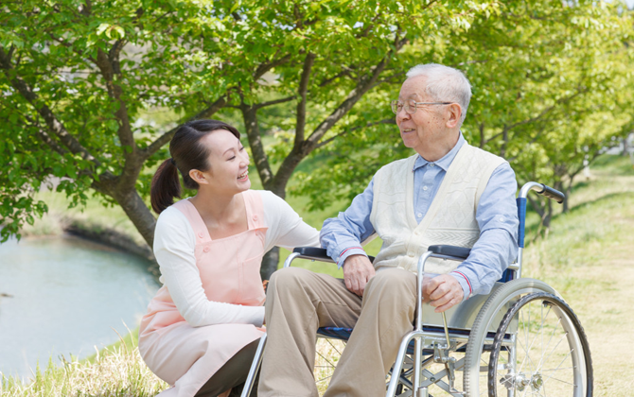
On the other hand, people with disability, especially physical disabilities, often experience pain and discomfort related to or in addition to their disability condition.
As people with physical disabilities also age, the frequency and severity of their pain and discomfort may also increase.
Work With Information About the Human Body

Slide 191
Categories of Pain and Discomfort
There are several ways to categorise pain. One is to separate it into acute pain and chronic pain:
Acute pain
Limited duration
Chronic pain
Longer duration and often resistant to medication
Work With Information About the Human Body

Slide 192
People respond to pain differently but for the sake of the discussion, you will be able to witness it.
The ways people may respond to pain and discomfort are as follows:
Emotional responses, e.g. anger, anxiety, despair
Feeling disempowered for not being able to do certain tasks due to the pain and discomfort
Feeling isolated
Behaviours of concern, e.g. self-injury
Work With Information About the Human Body

Slide 193
Communication is essential in understanding your client’s pain and discomfort.
It is essential that you use a variety of communication methods that:
Reflect current industry and workplace best practices in individualised support – ageing or disability support.
Is relevant to communicating with people in pain and discomfort
Is within the scope of the support worker’s role and responsibilities.
Work With Information About the Human Body

Slide 194
Below are the ways you can effectively communicate with people who are in pain and discomfort:
Remaining calm and showing empathy
Using ‘I’ instead of ‘you’ statements, e.g. ‘I would like you to take this medication instead of ‘you need to take this medication.’
Reassuring the person that you are there to relieve their pain and discomfort.
Expressing concern for their feelings of pain and discomfort
Work With Information About the Human Body

Slide 195
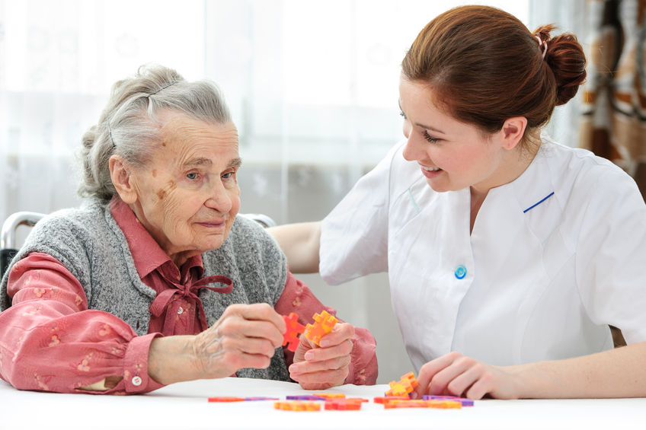
Below are the ways you can effectively communicate with people who are in pain and discomfort:
Using active listening, e.g. paraphrasing, summarising, appropriate eye contact.
Work With Information About the Human Body

Slide 196
Common Causes of Pain and Discomfort
Common causes of pain in older people may include:
Arthritis
Fibromyalgia
Cancer
Circulatory problems
Bowel disease
Urinary tract infections
Pressure injuries
Old injuries
Infections
Work With Information About the Human Body

Slide 197
Assessing Pain and Discomfort
Unless an obvious injury has occurred, it can be difficult to tell if a patient is experiencing pain.
Everyone has different levels of pain tolerance, which is why pain rating systems are used.
These systems generally use a 0 to 10 scale where 0 is no pain and 10 is the worst pain ever experienced.
Work With Information About the Human Body

Slide 198

Healthcare professionals will ask patients what pain level is acceptable to them to help figure out when pain medication should be given.
Many pain rating scales are available, and a pain scale with faces is frequently used.
This tool effectively assesses the pain of anyone over the age of 3.
Work With Information About the Human Body

Slide 199
Types of Pain Scales
There are at least ten pain scales being used today.
They generally fall into one of the three categories below:
Numerical rating scales (NRS)
Visual Analog Scales (VAS)
Categorical Scales
Work With Information About the Human Body

Slide 200
Some of the pain scales used to gauge pain are listed below:
The Abbey pain scale - This is used mainly as the measurement of pain for people who cannot verbalise.
Wong-Baker Faces Pain Scale - The Wong-Baker FACES Pain Scale combines pictures and numbers to rate pain.
Descriptor Differential Scale of Pain Intensity - This scale has 12 lines, each with a description (e.g. faint, strong, intense, and very intense).
Work With Information About the Human Body

Slide 201
1.2.5 Procedures to Follow for Monitoring and Reporting Pain
You can teach your clients how to observe and report the pain they experience.
This report can either be to you or any other worker responsible for the client's well-being in the community service.
Self-report is definitely one of the most reliable sources of information on pain.
Use it with all your clients, including those with a cognitive or communication impairment.
Work With Information About the Human Body

Slide 202
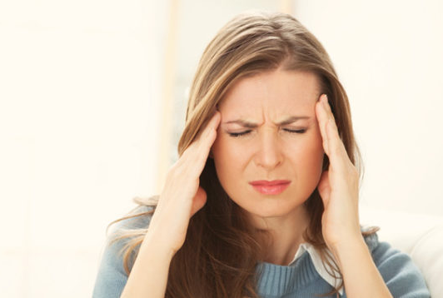
Self-report of pain may be obtained by:
Asking an older person question about their pain
Using a pain intensity scale
Using a multidimensional self-report tool
Work With Information About the Human Body

Slide 203
It is important to take self-reports seriously, including those from older people with cognitive impairment.
Another option for reporting issues, pain and discomfort experienced by the client will be done by you through observation and interview.
In older people who have severe cognitive impairments or communication difficulties, their behaviour may be the only indication of pain.
Work With Information About the Human Body

Slide 204
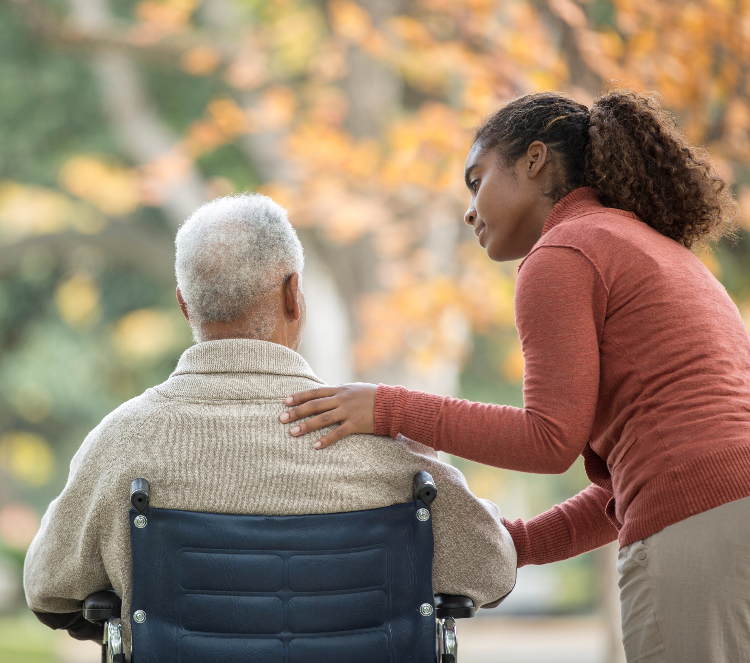
Pain behaviours are individual, so identifying pain often requires background in body systems and familiarity with the client. Involving the family and carers can help with identifying and confirming observational pains.
Work With Information About the Human Body

Slide 205

What have we learnt?
In this part of the session, we have covered:
Work with information about the human body
Recognise and promote ways to support healthy functioning of the body

Slide 206
End of Chapter 1

